Slide 1
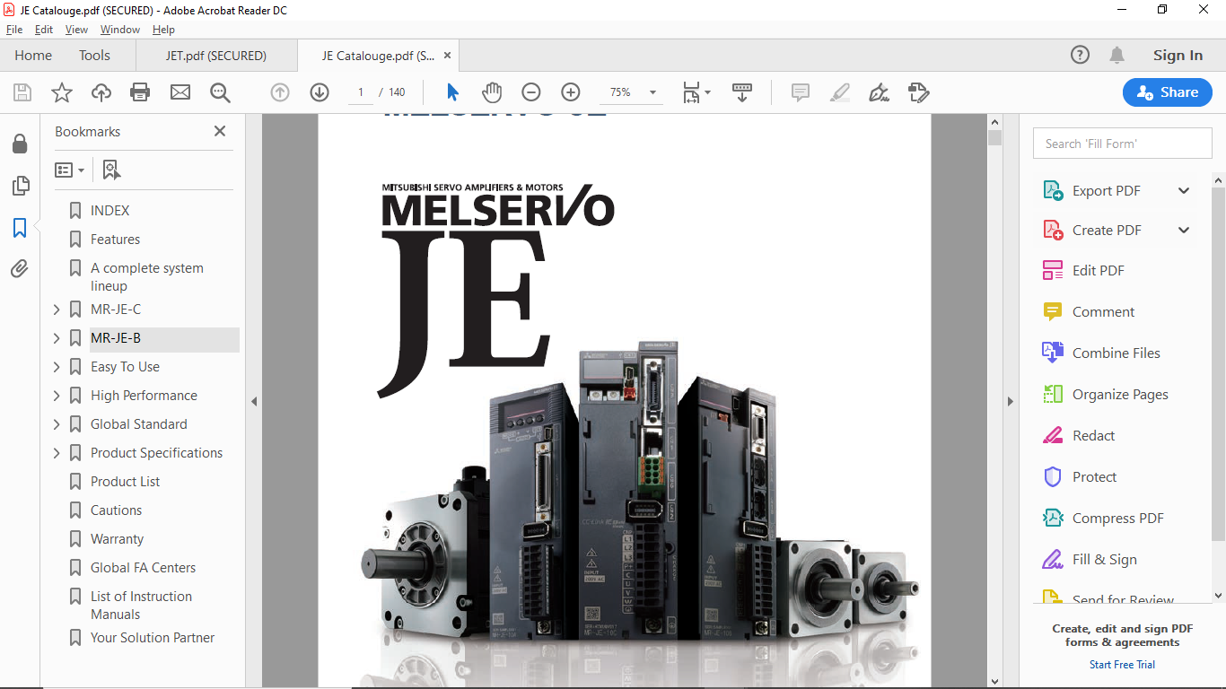
MR-JEC Basic Training
Notes:
With Mitsubishi’s commitment to total system solutions and global support the MELSERVO-JE becomes the answer to the world-wide needs in driving system.

Slide 2

MR-JEC Product Range

Slide 3
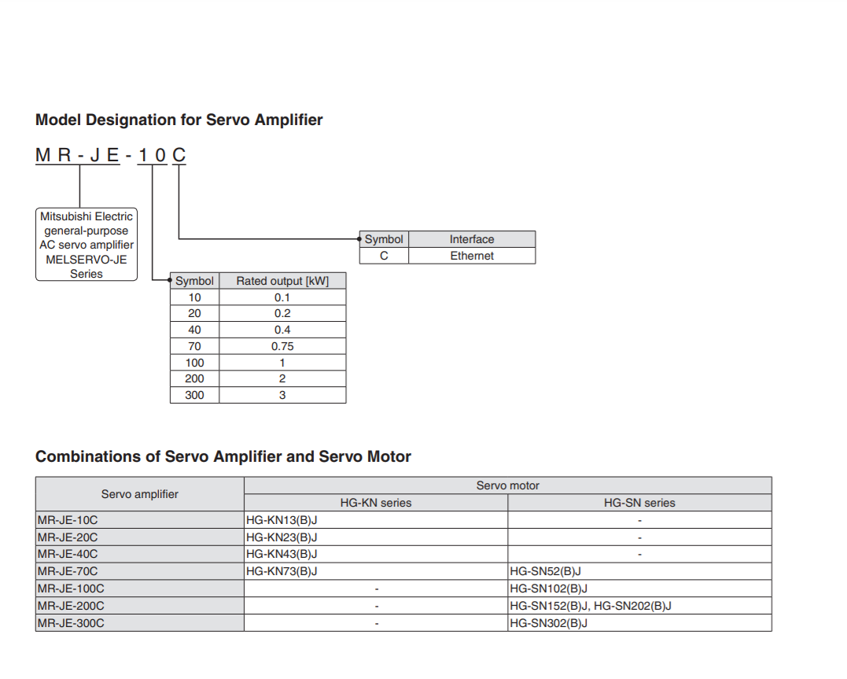
Model Designation

Slide 4
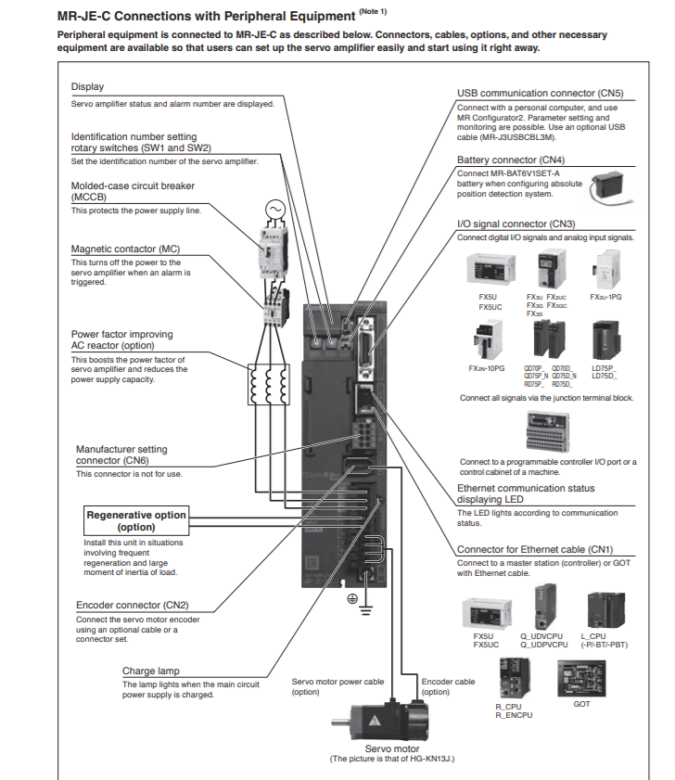
MR-JEC Connections and Peripherals Equipment

Slide 5
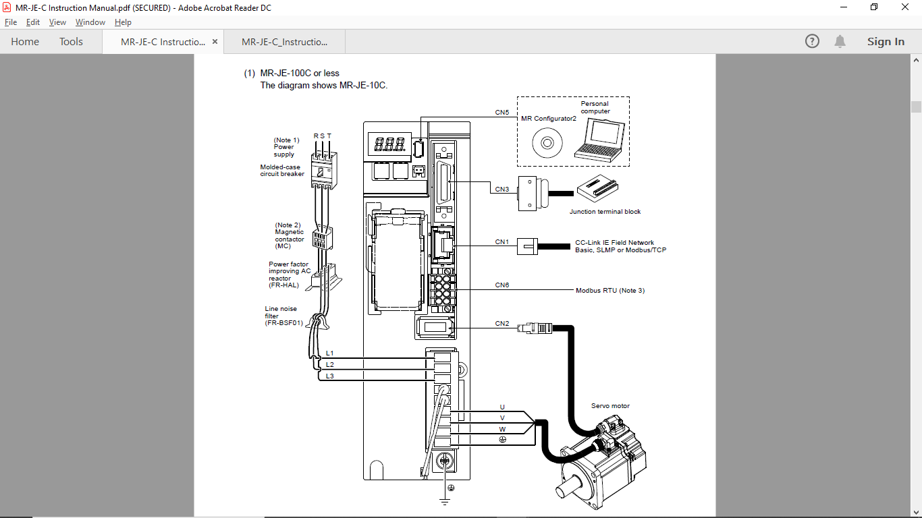
MR-JEC Connections and Peripherals Equipment
Notes:
With Mitsubishi’s commitment to total system solutions and global support the MELSERVO-JE becomes the answer to the world-wide needs in driving system.

Slide 6
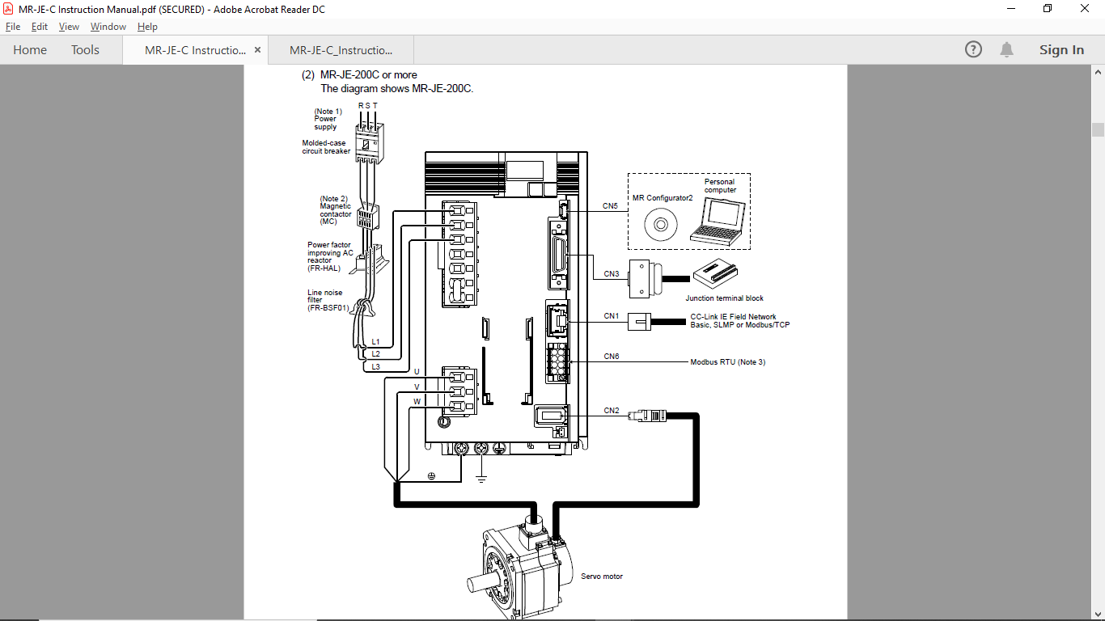
MR-JEC Connections and Peripherals Equipment
Notes:
With Mitsubishi’s commitment to total system solutions and global support the MELSERVO-JE becomes the answer to the world-wide needs in driving system.

Slide 7
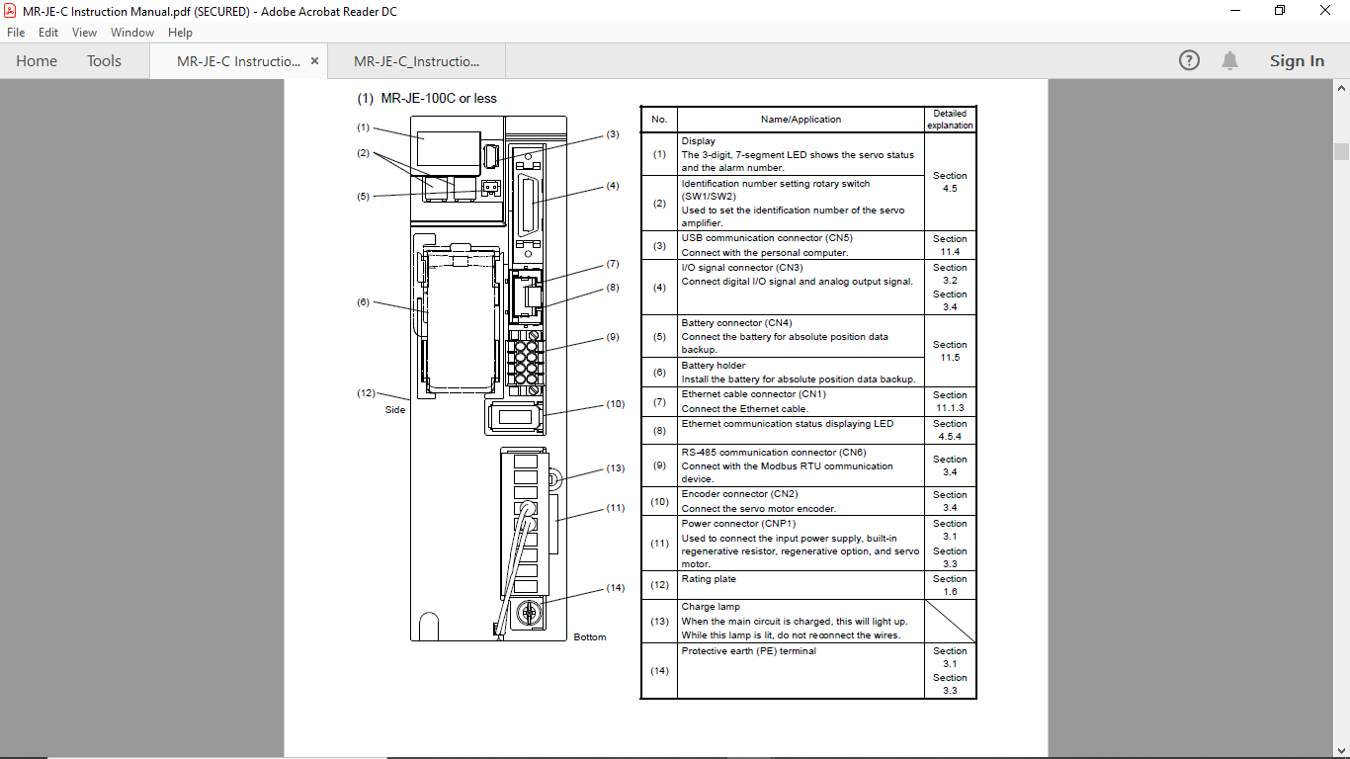
Architecture-1
Notes:
With Mitsubishi’s commitment to total system solutions and global support the MELSERVO-JE becomes the answer to the world-wide needs in driving system.

Slide 8
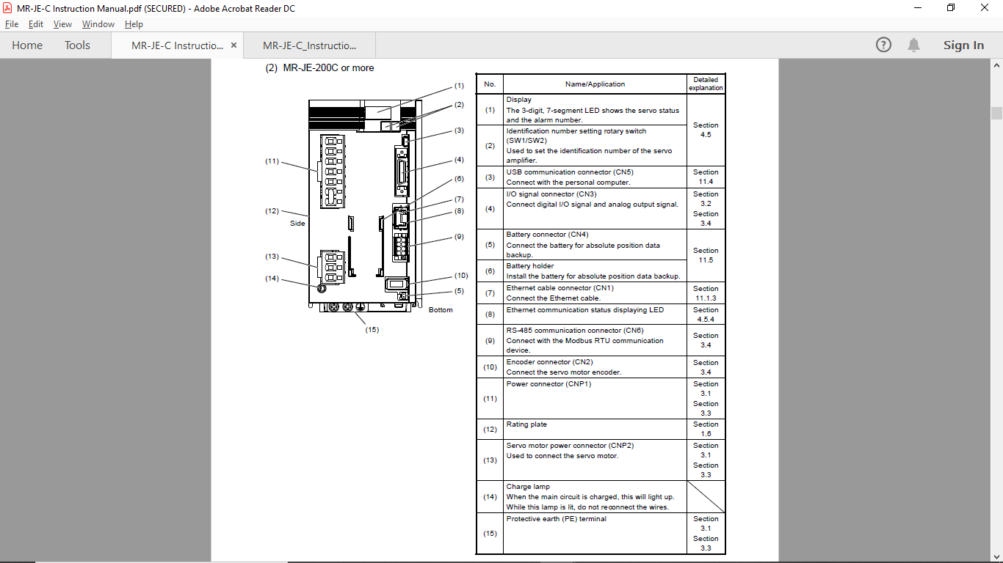
Architecture-2
Notes:
With Mitsubishi’s commitment to total system solutions and global support the MELSERVO-JE becomes the answer to the world-wide needs in driving system.

Slide 9
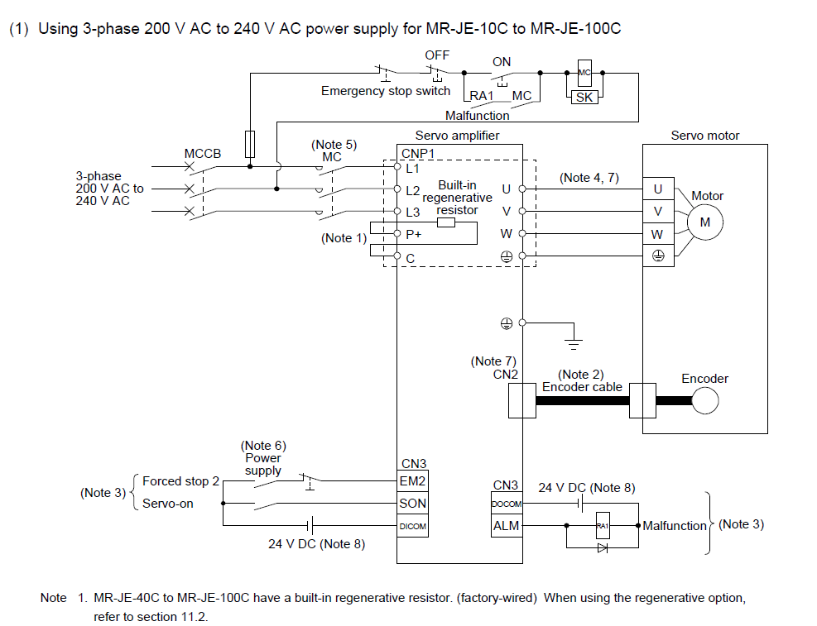
Power Supply Connections (1)
Notes:
With Mitsubishi’s commitment to total system solutions and global support the MELSERVO-JE becomes the answer to the world-wide needs in driving system.

Slide 10
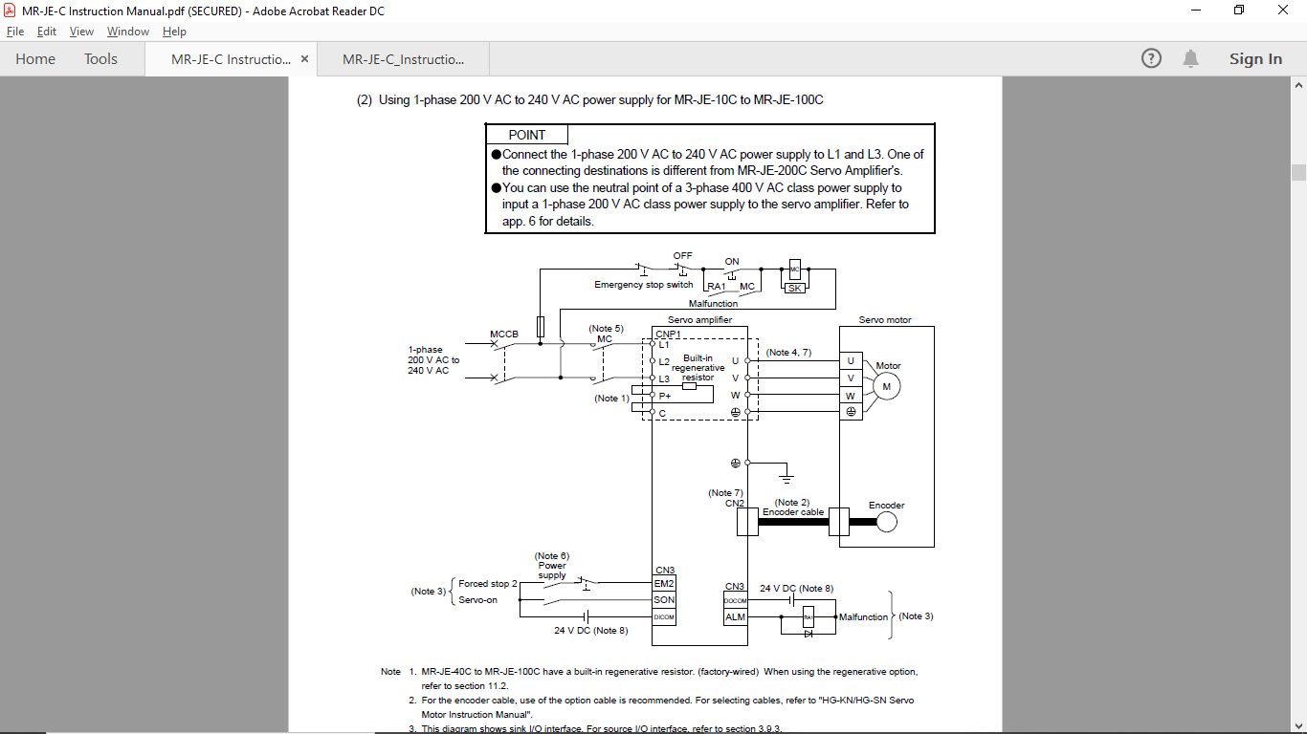
Power Supply Connections (2)
Notes:
With Mitsubishi’s commitment to total system solutions and global support the MELSERVO-JE becomes the answer to the world-wide needs in driving system.

Slide 11
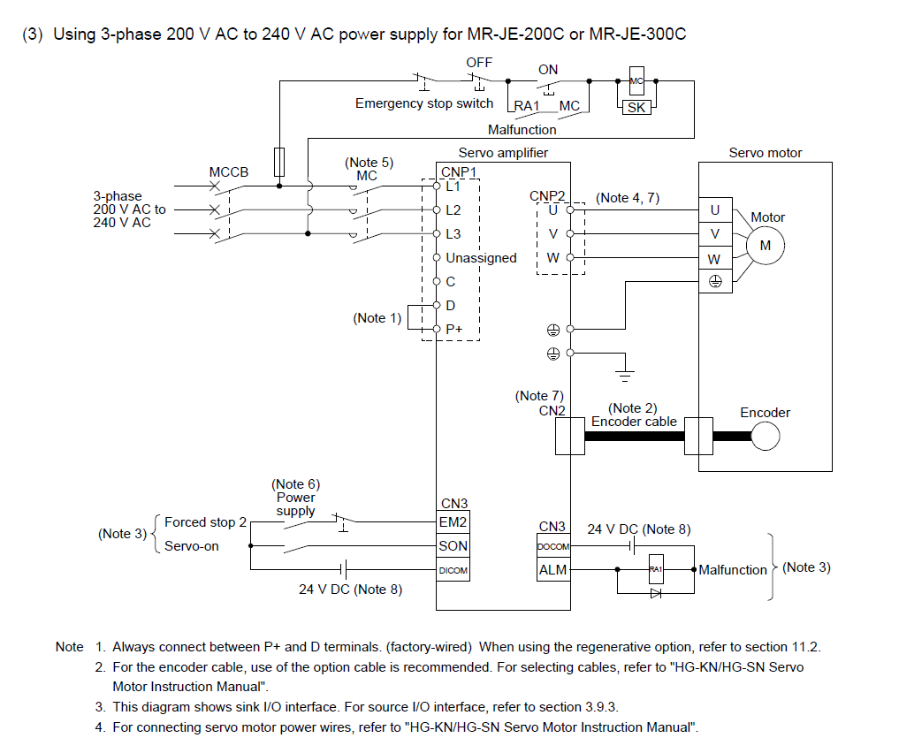
Power Supply Connections (3)
Notes:
With Mitsubishi’s commitment to total system solutions and global support the MELSERVO-JE becomes the answer to the world-wide needs in driving system.

Slide 12
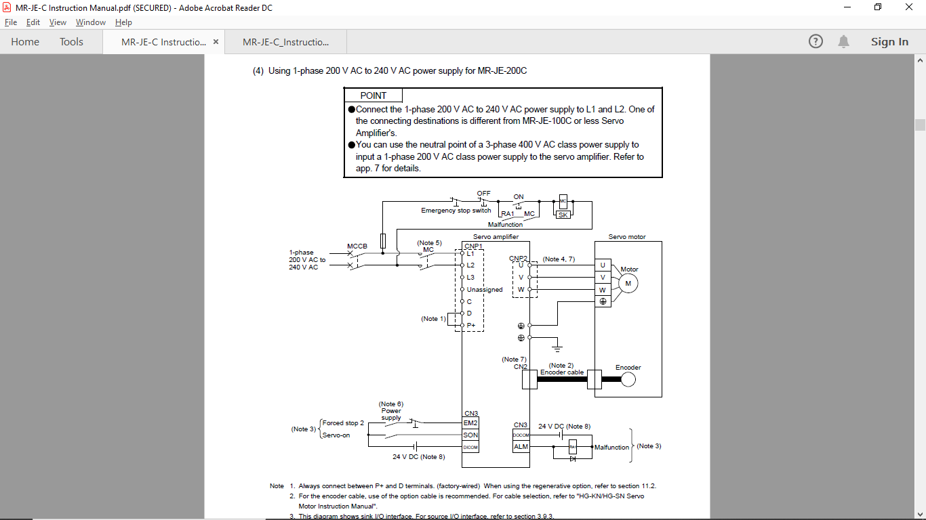
Power Supply Connections (4)
Notes:
With Mitsubishi’s commitment to total system solutions and global support the MELSERVO-JE becomes the answer to the world-wide needs in driving system.

Slide 13
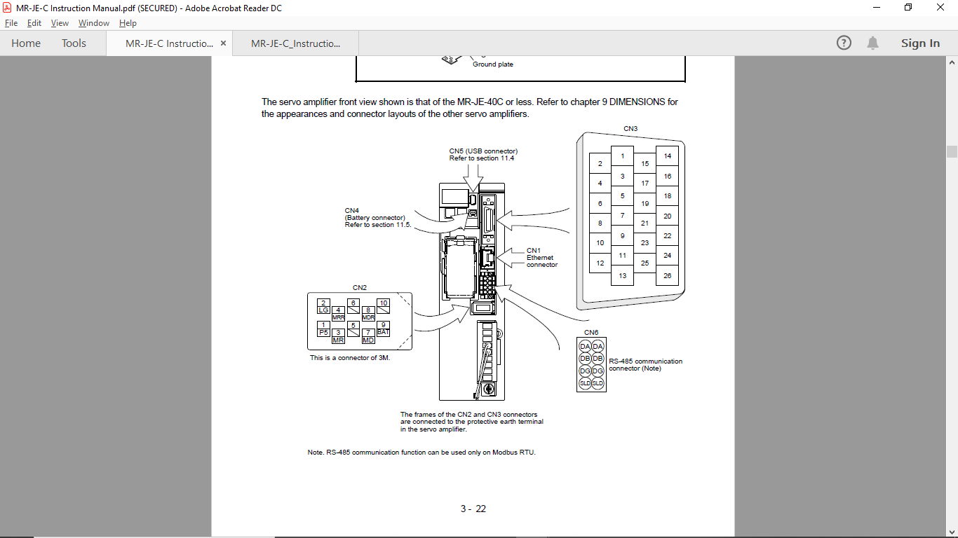
Connector Pins CN1,CN2,CN3 & CN6
Notes:
With Mitsubishi’s commitment to total system solutions and global support the MELSERVO-JE becomes the answer to the world-wide needs in driving system.

Slide 14
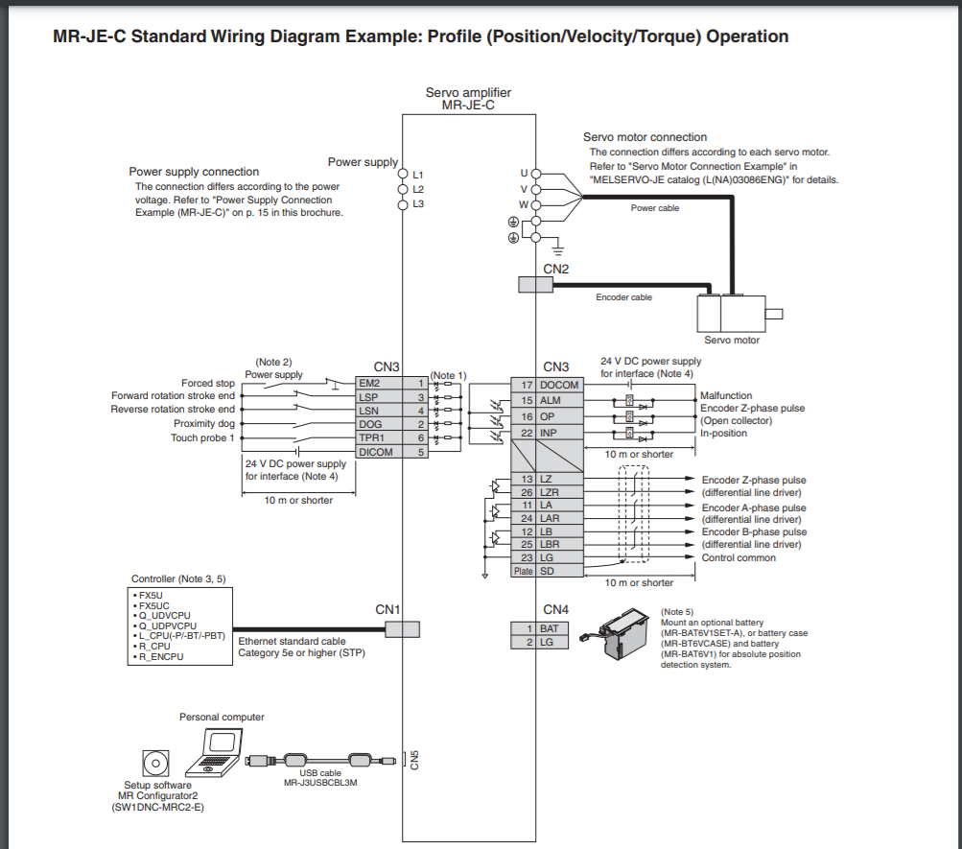
CCLink IE Field Basic-Profile Mode Connection Layout

Slide 15
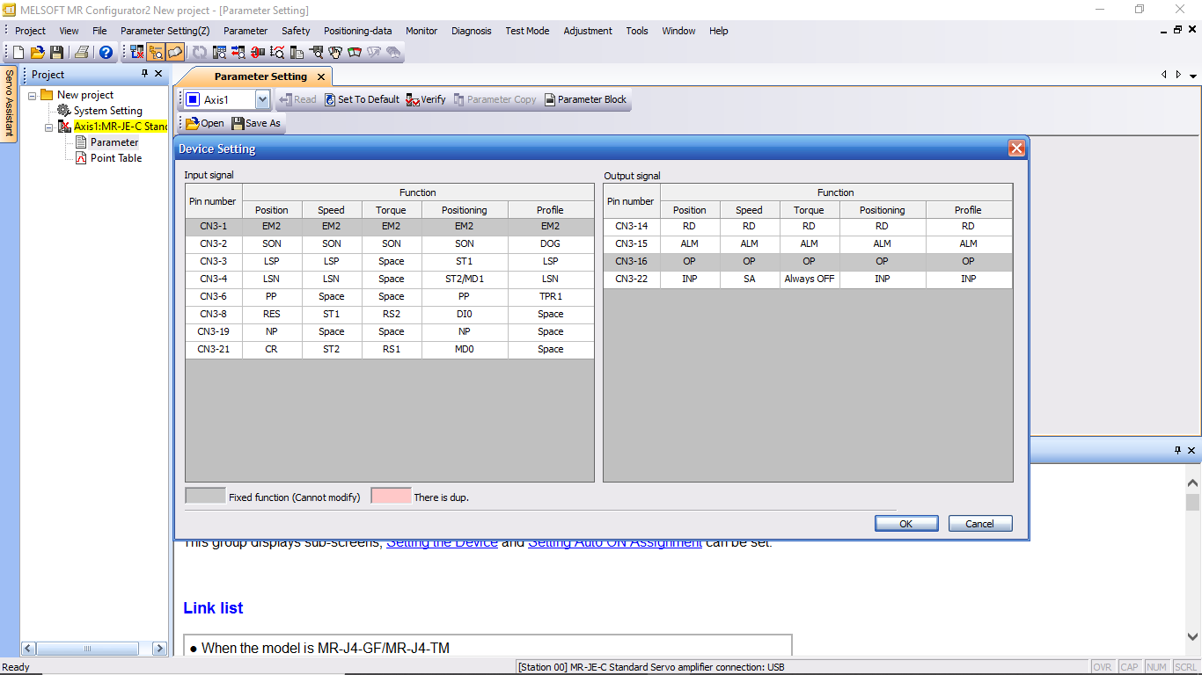
Notes:
With Mitsubishi’s commitment to total system solutions and global support the MELSERVO-JE becomes the answer to the world-wide needs in driving system.

Slide 16
Operation Modes
Basic Mode | Position Control | Speed Control | Torque Control
Positioning Mode | Point Table Method | Indexer Method
Profile Mode | Position Control | Speed Control | Torque Control
Notes:
With Mitsubishi’s commitment to total system solutions and global support the MELSERVO-JE becomes the answer to the world-wide needs in driving system.

Slide 17
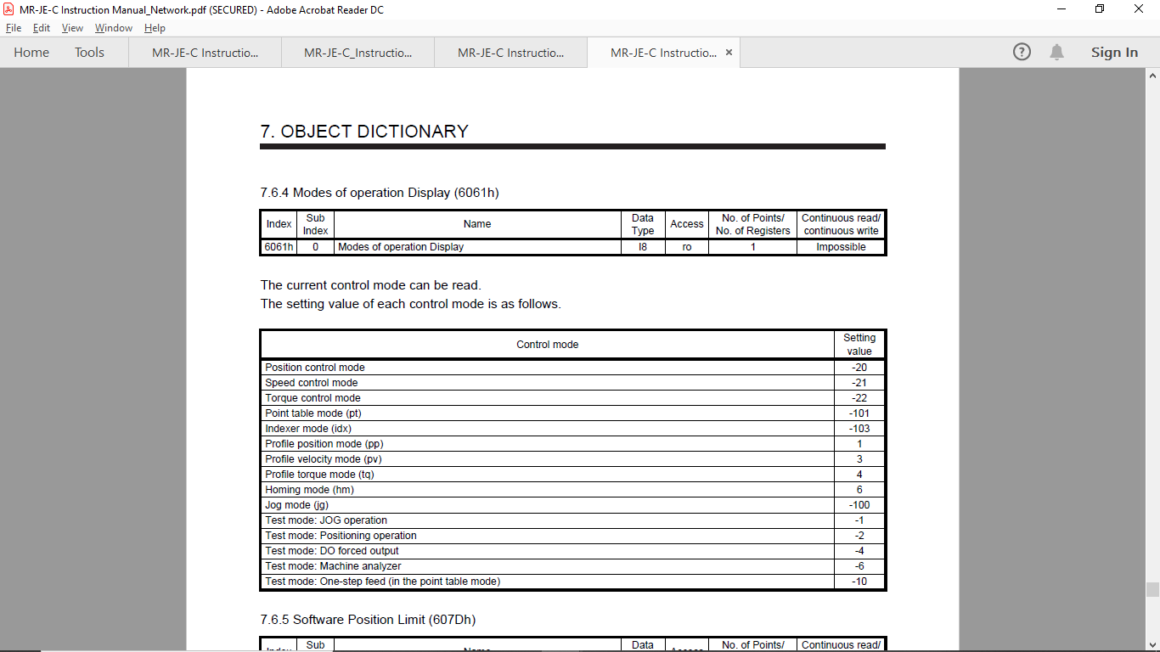
Notes:
With Mitsubishi’s commitment to total system solutions and global support the MELSERVO-JE becomes the answer to the world-wide needs in driving system.

Slide 18
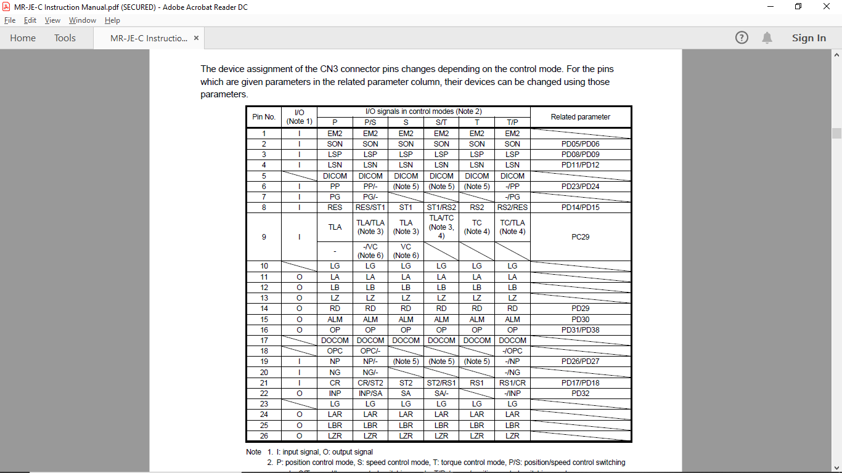
Notes:
With Mitsubishi’s commitment to total system solutions and global support the MELSERVO-JE becomes the answer to the world-wide needs in driving system.

Slide 19
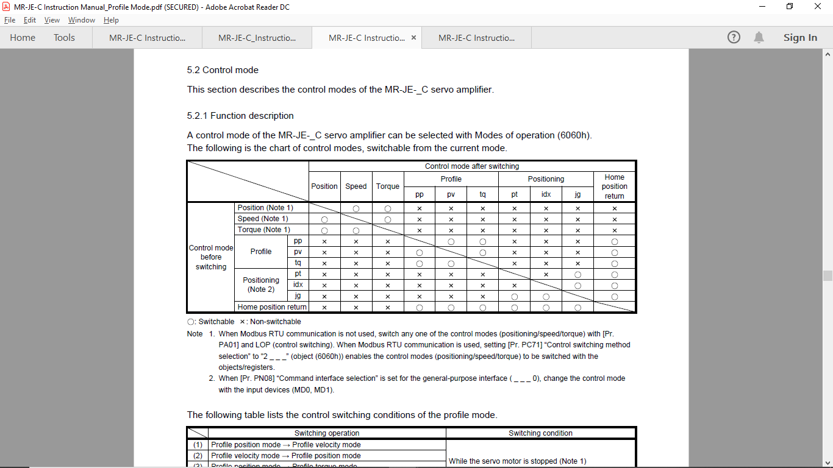
Notes:
With Mitsubishi’s commitment to total system solutions and global support the MELSERVO-JE becomes the answer to the world-wide needs in driving system.

Slide 20

Thank You

Slide 21
MR-JEC Programming

Slide 22
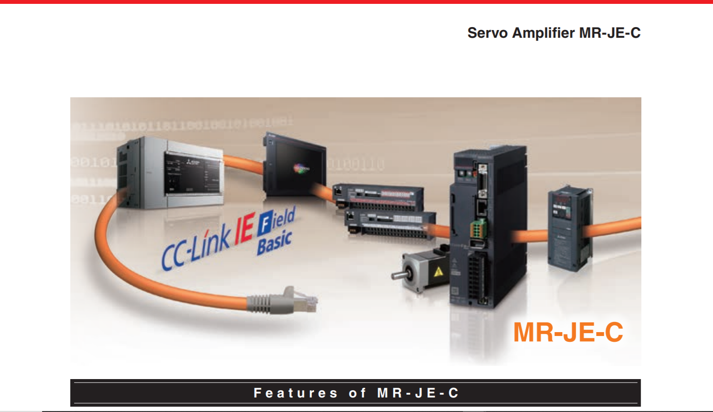
MR-JEC Profile mode on CC Link IE Field Basic
Profile mode
Example of Profile Position
Notes:
With Mitsubishi’s commitment to total system solutions and global support the MELSERVO-JE becomes the answer to the world-wide needs in driving system.

Slide 23
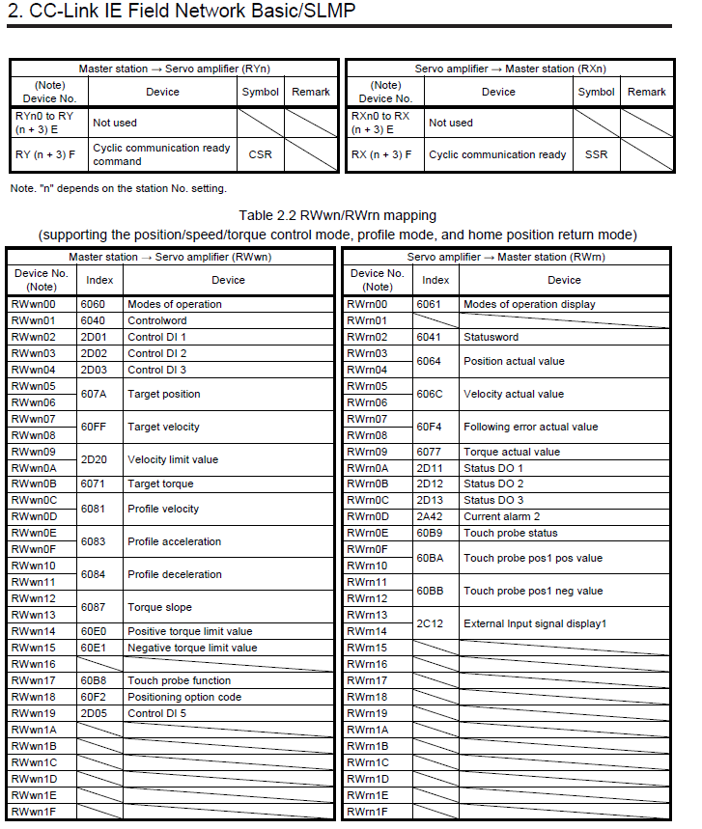
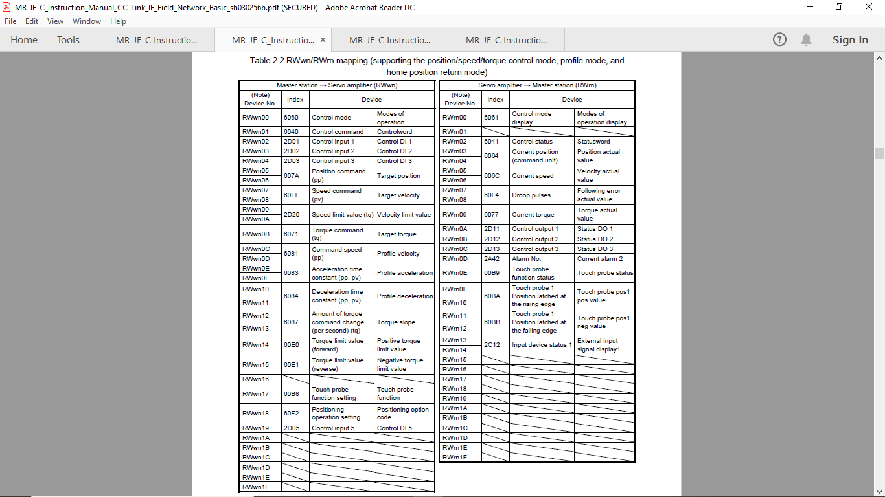
Read Write Assembly-CiA402 Profile Mode
Notes:
With Mitsubishi’s commitment to total system solutions and global support the MELSERVO-JE becomes the answer to the world-wide needs in driving system.

Slide 24

Creating GX Works3 Program
->Open GX Works3 Software in your PC

Slide 25
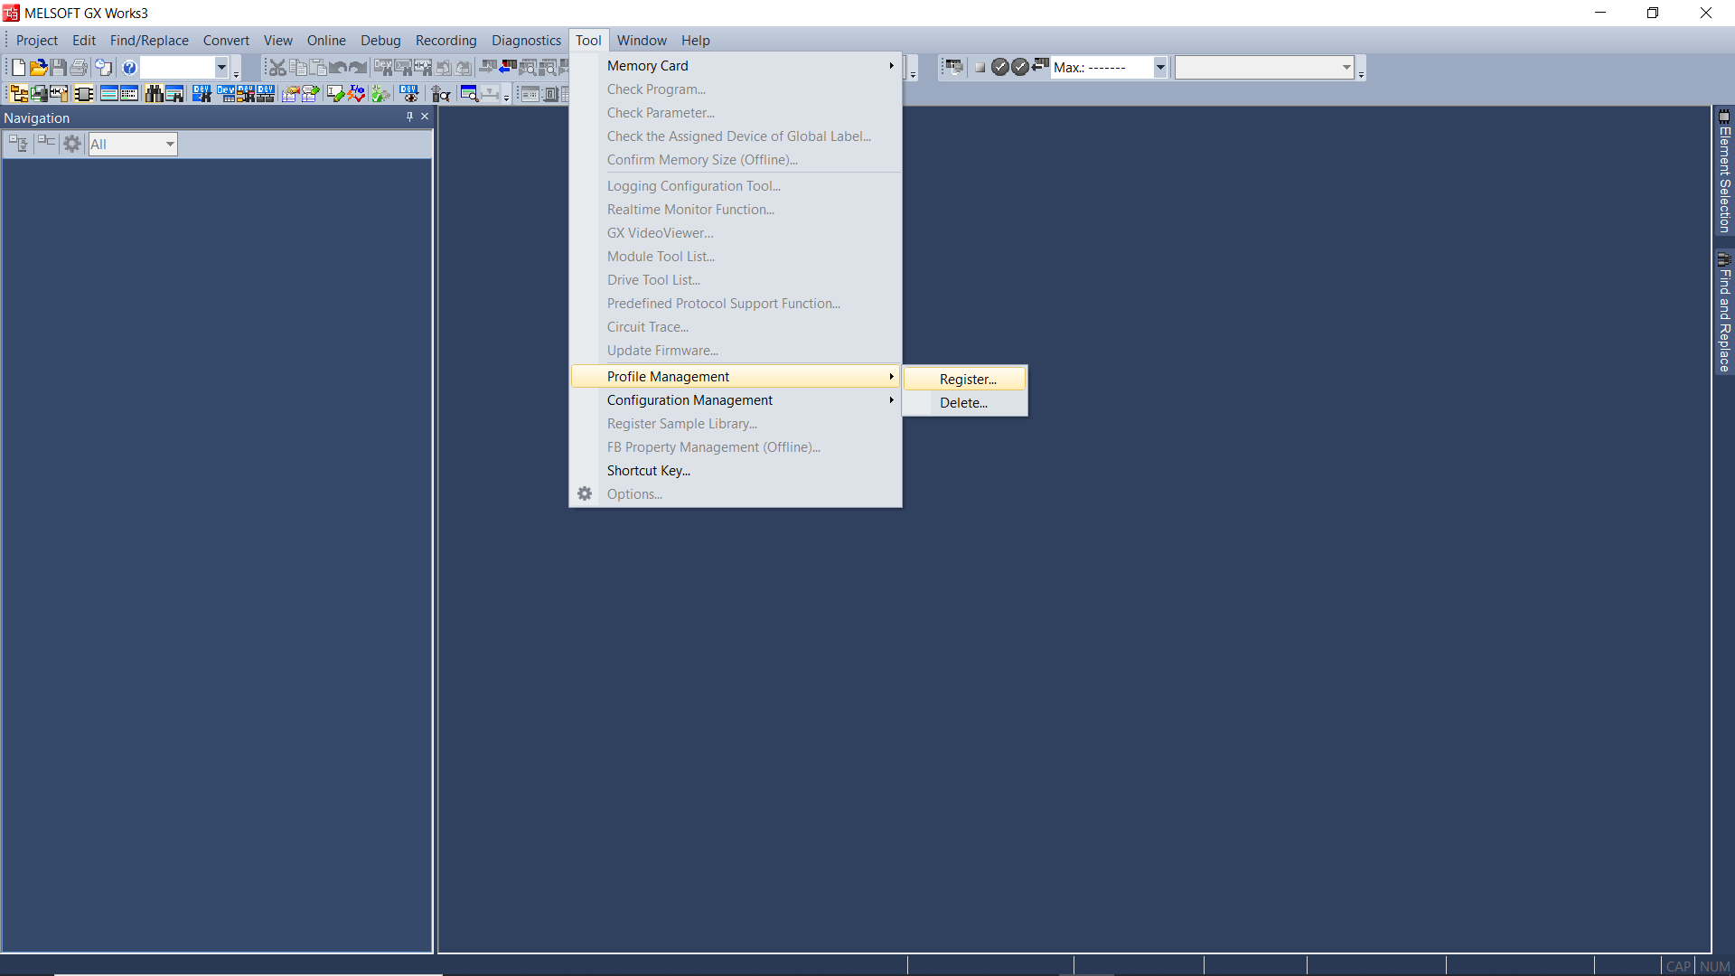
Step1 – Add MR-JEC Add-on Profile in GXWorks3
Steps – Open GXWorks3 ->Tool ->Profile Management-> Register->Add .cspp File

Slide 26
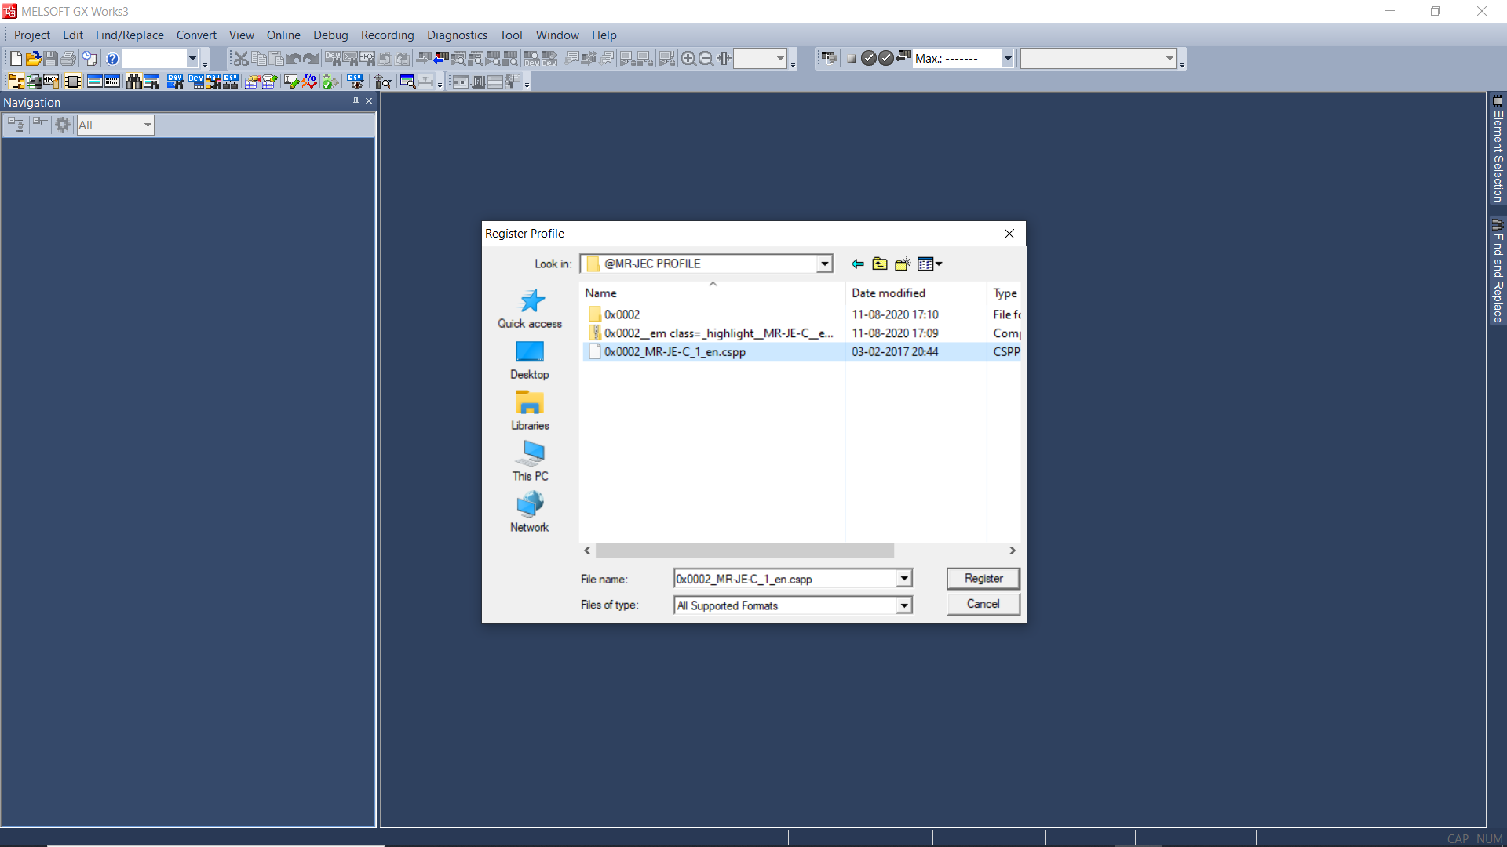
-> Add .cspp File of MR-JEC & Register

Slide 27
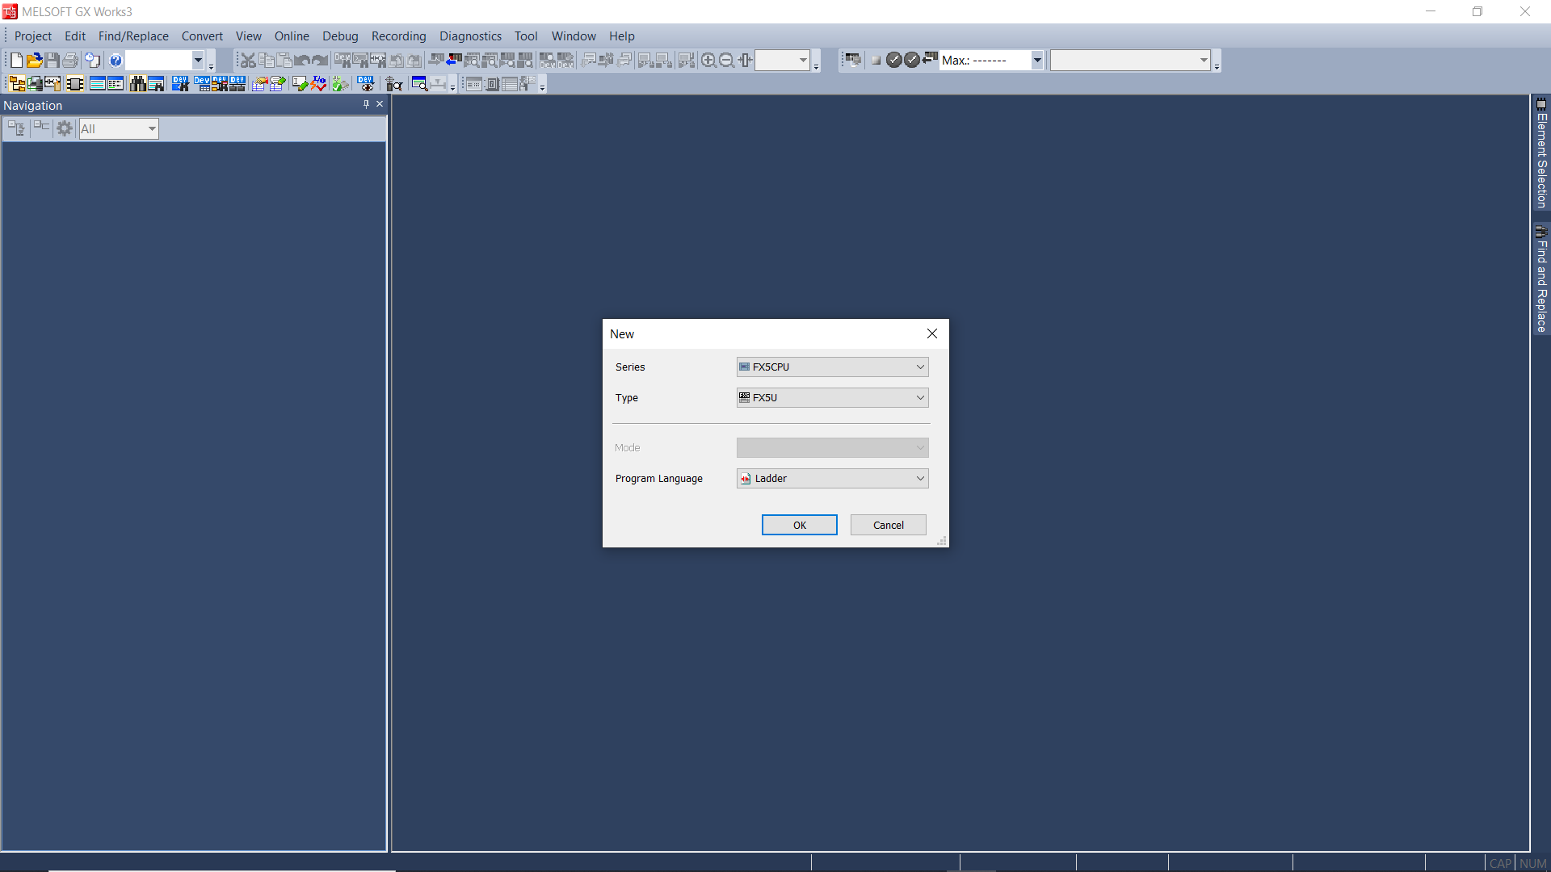
Step2- Create GXWorks3 Program
-> Now We will Create FX5U Program & will do CCLink IE Field Basic Settings

Slide 28
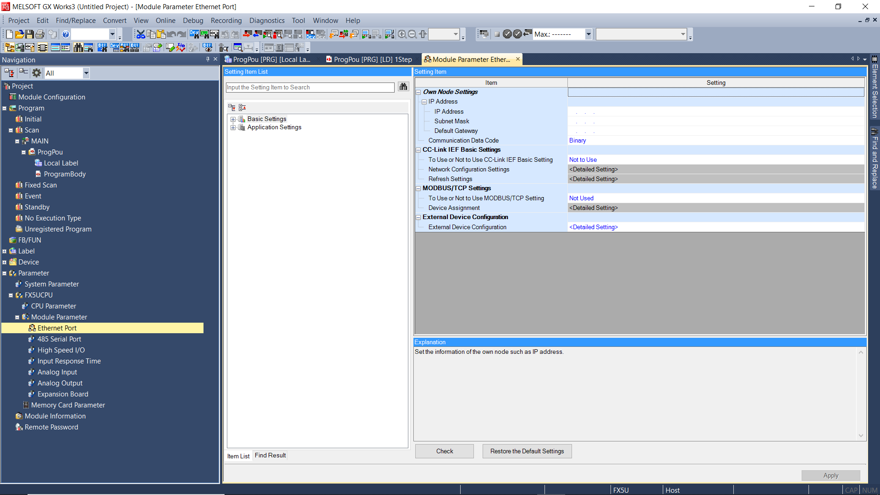
->Open Ethernet Port Settings

Slide 29
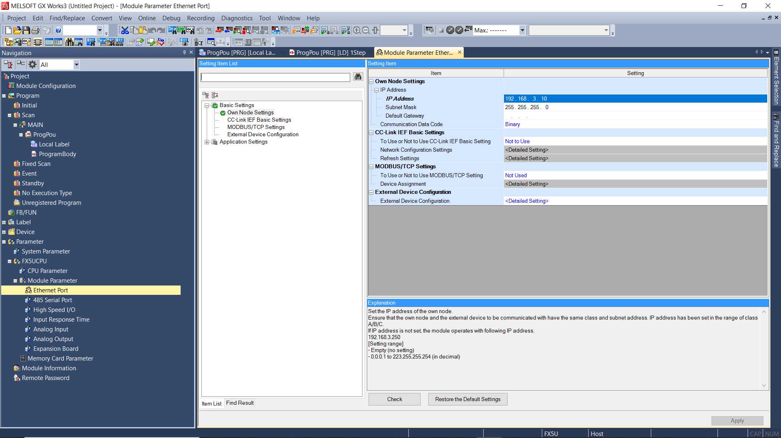
->Assign PLC IP Address

Slide 30
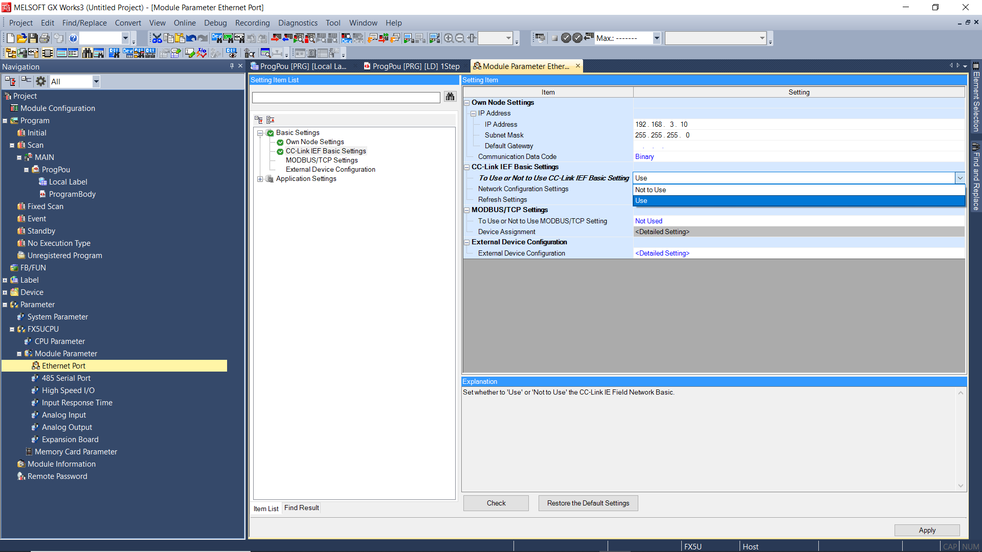
->Open CC Link IE Field Basic Setting and Select “Use ”

Slide 31
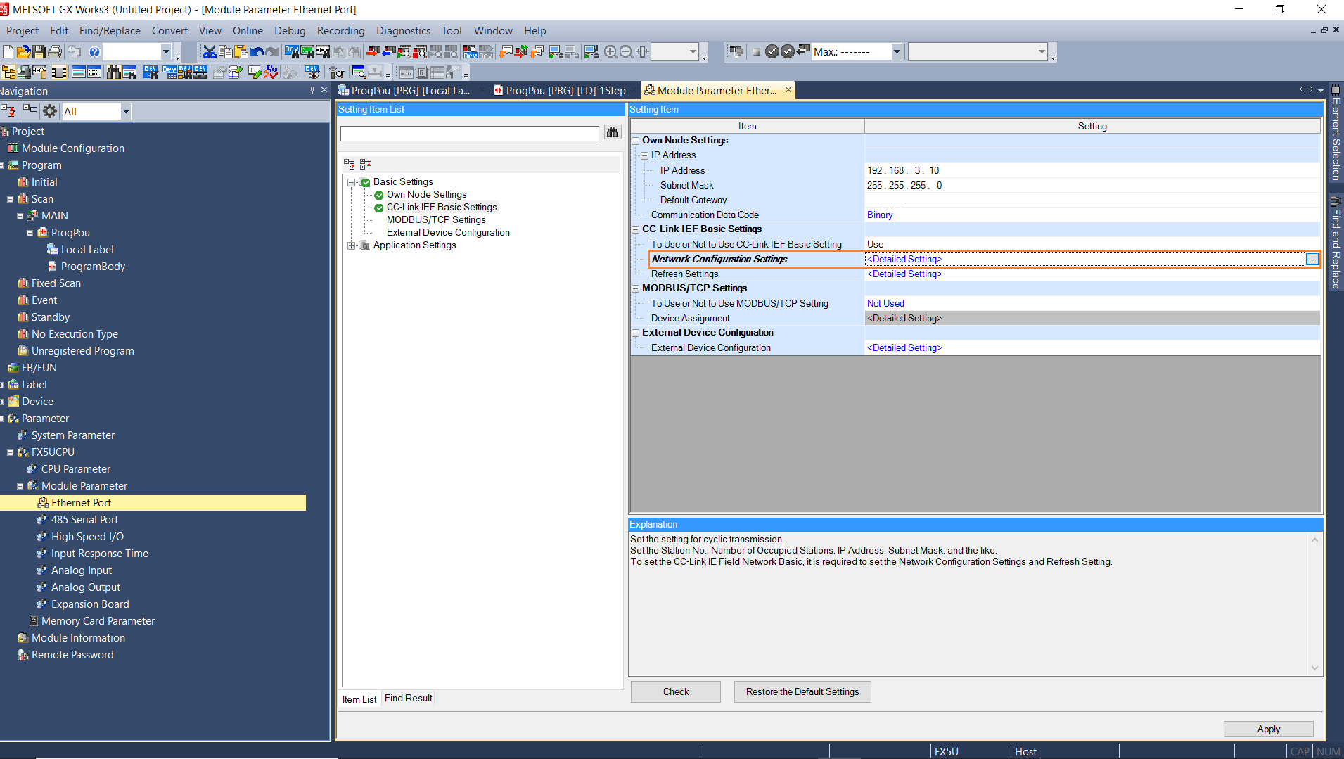
->Open Network Configuration Settings

Slide 32
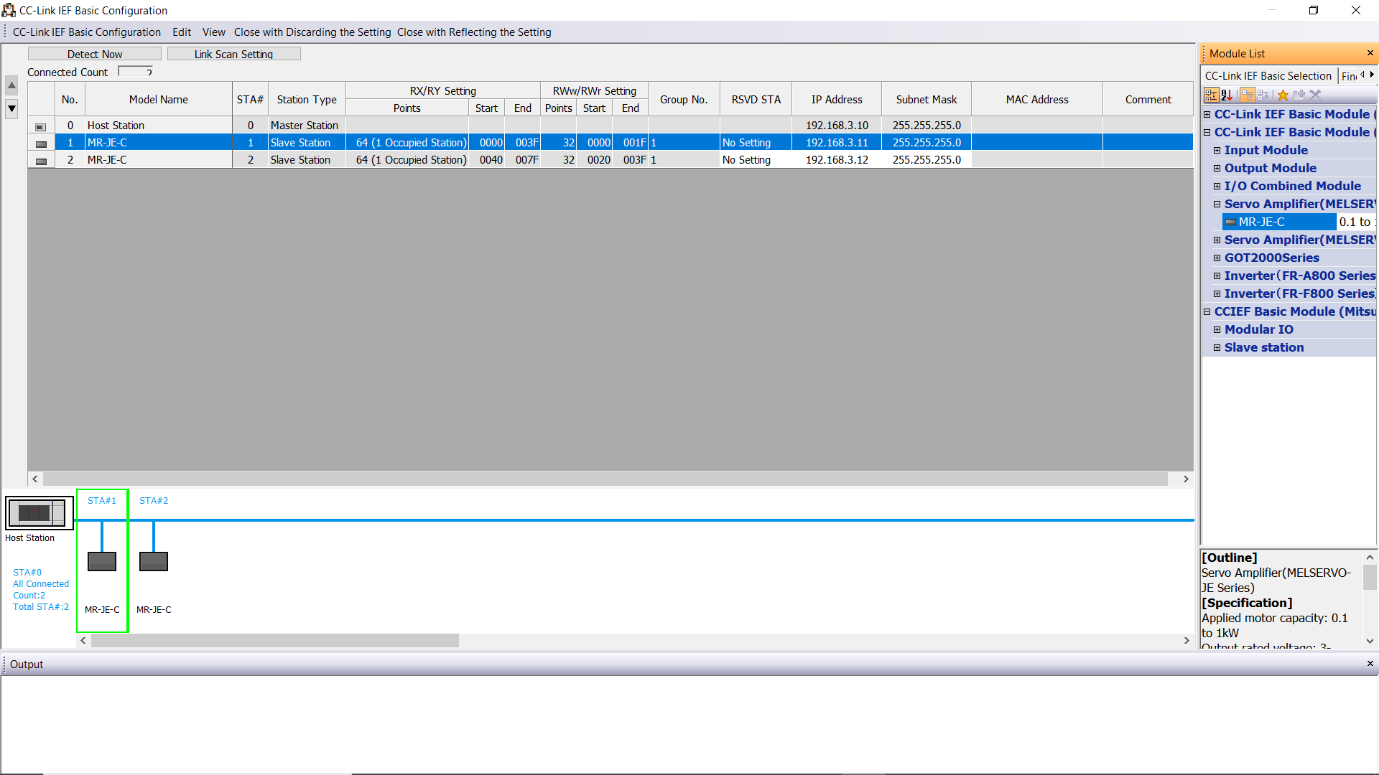
-> Add No. of MR-JEC Axes required and Set the IP Address for each Axis

Slide 33
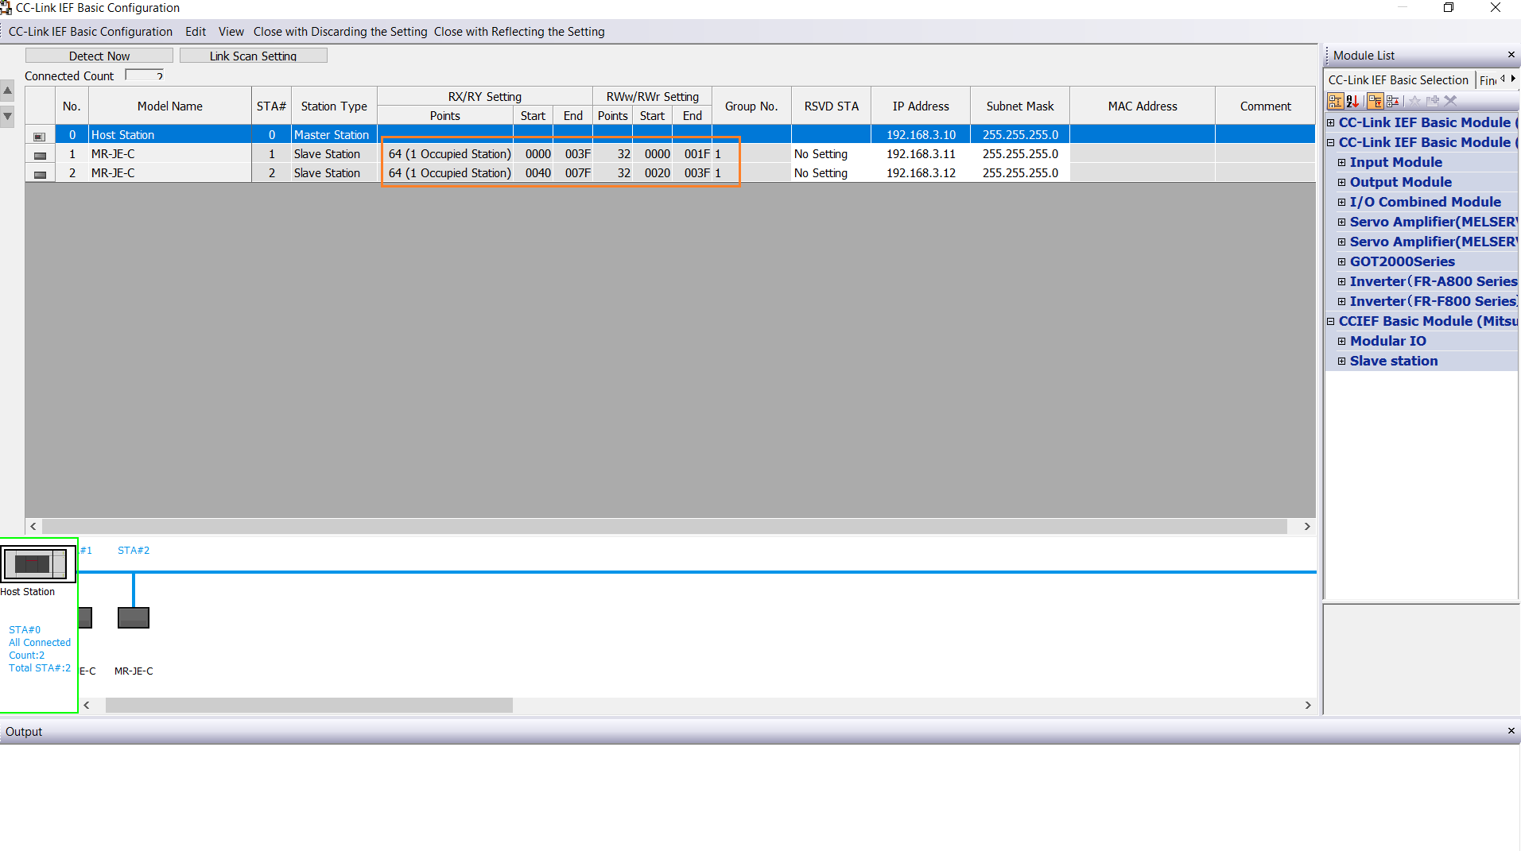
-> Observe the Read/Write Assembly Size

Slide 34
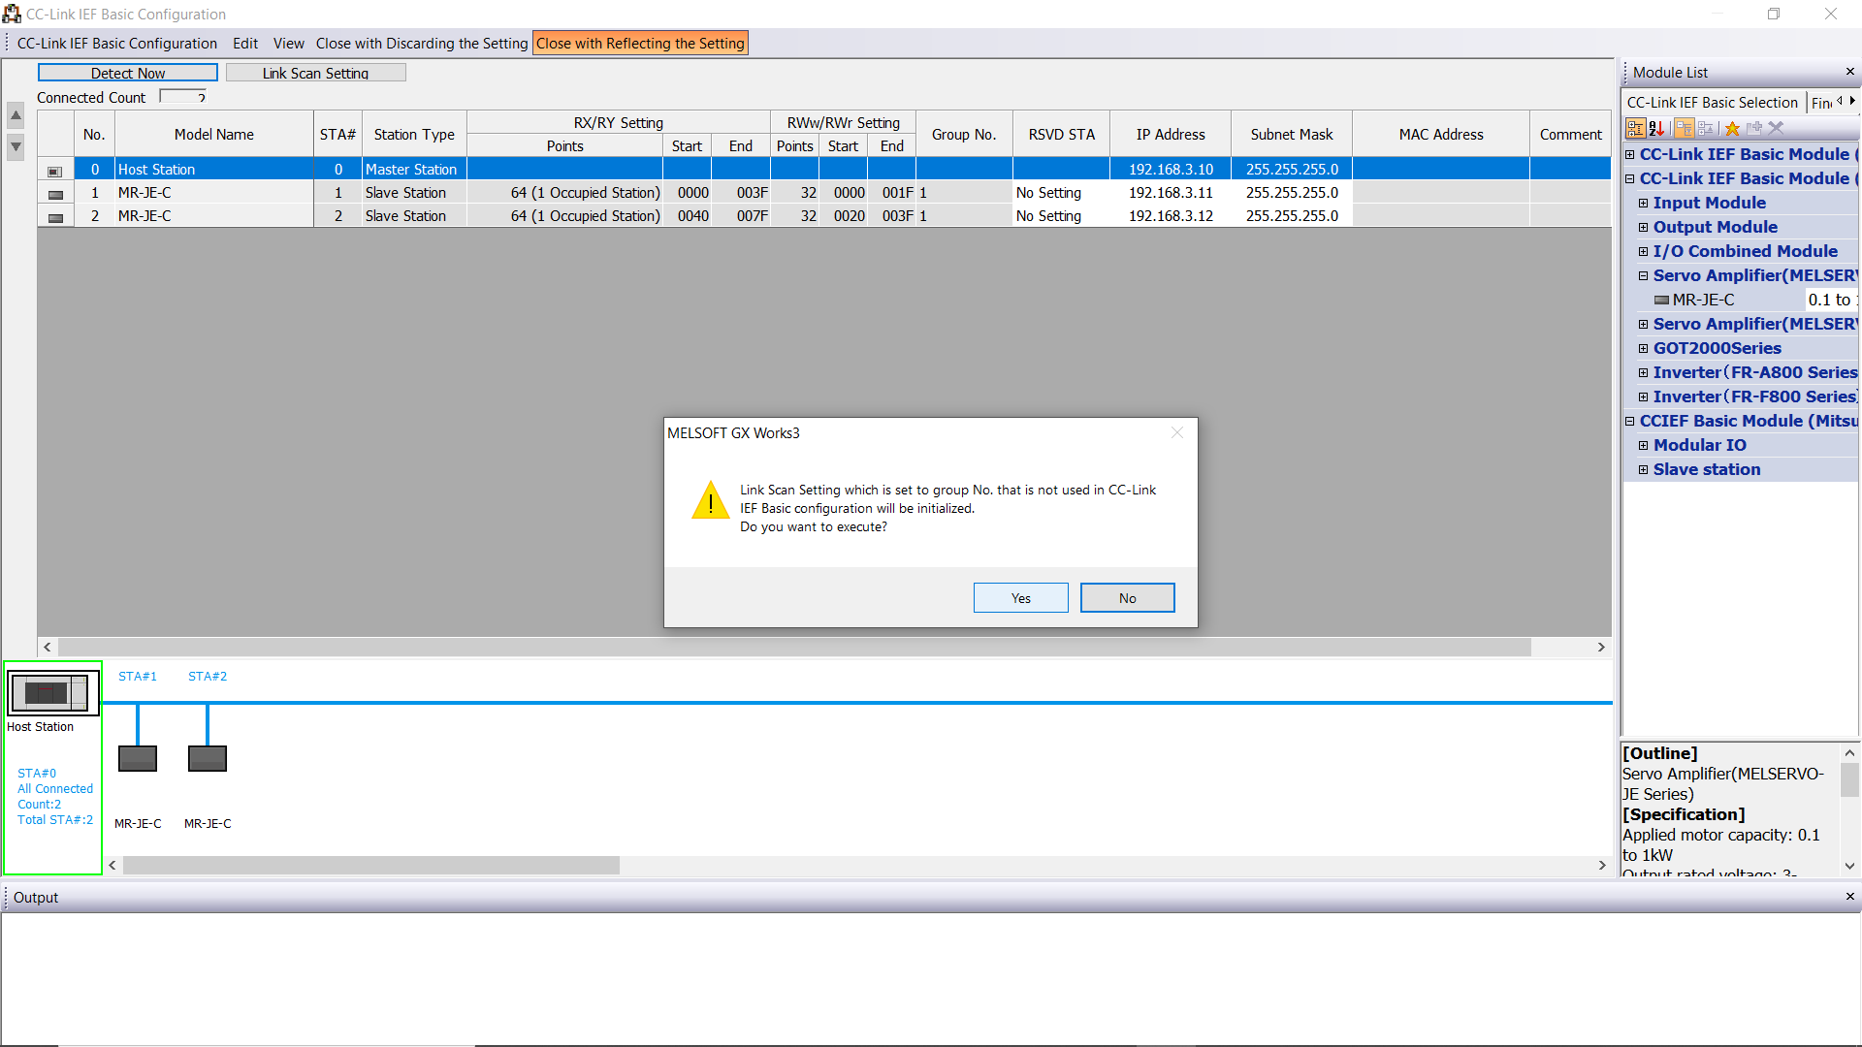
->Close with Reflecting the Setting, Press Yes

Slide 35

->Open Refresh Settings under CC Link IE Field Basic Setting Tab

Slide 36
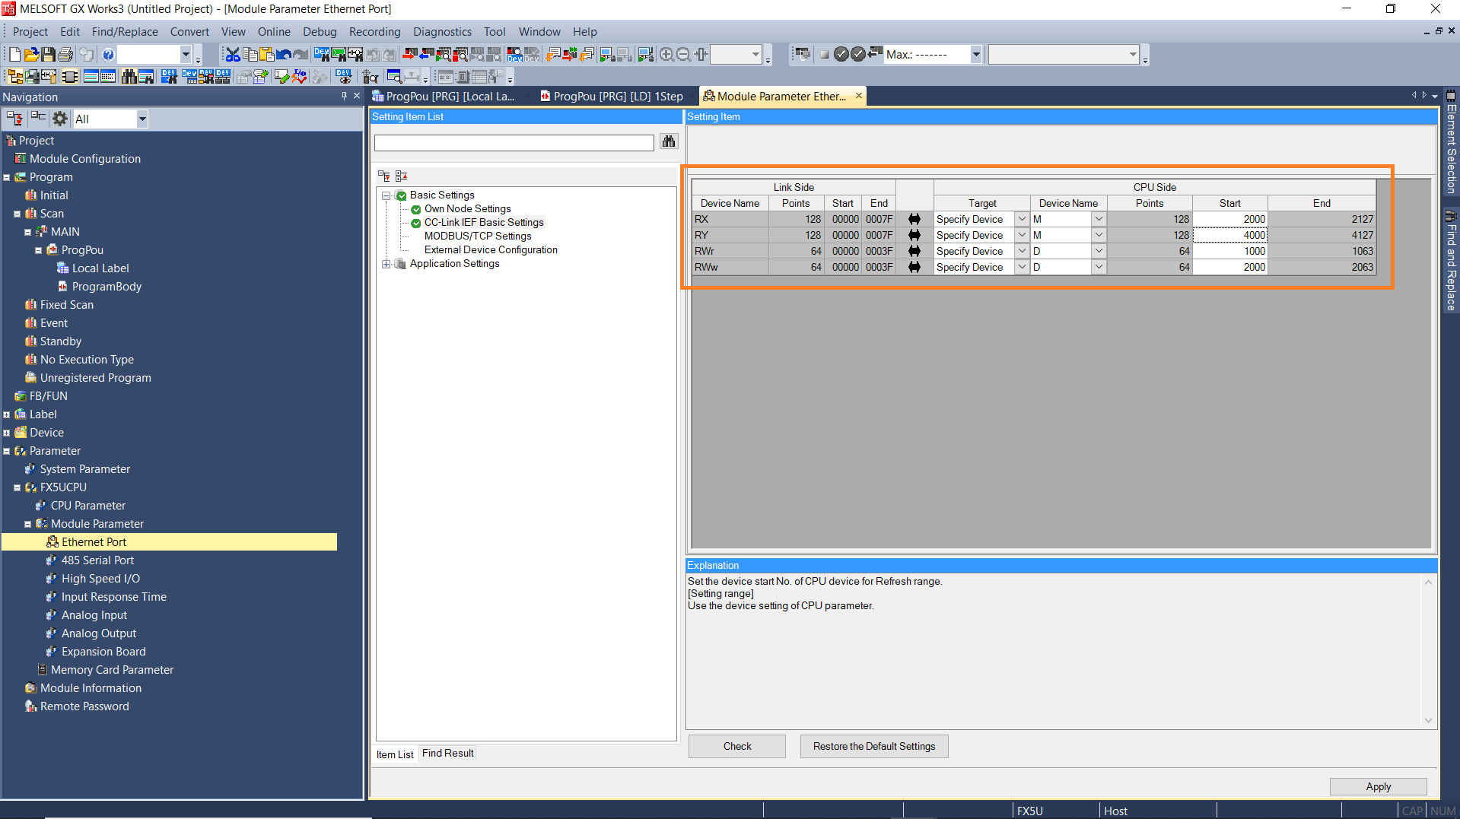
->Specify applicable devices for Rx, Ry, RWr and RWw Assembly and Apply it.
-> For 1 Station, Rx-64 Bits , RY-64 Bits , RWr- 32 16Bit Register & RWw- 32 16Bit Register required

Slide 37
MR-JEC Read/Write Assembly
(From Network Instruction Manual)

Slide 38
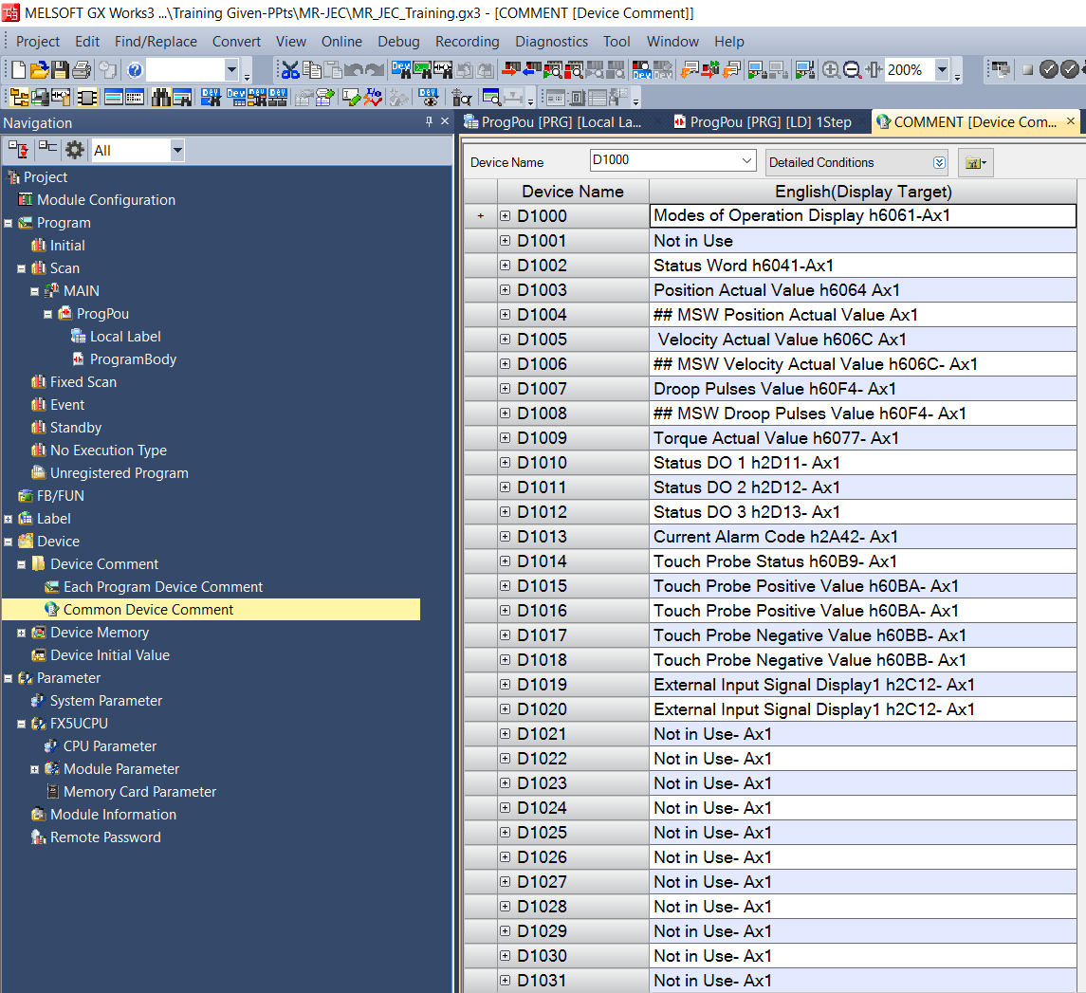
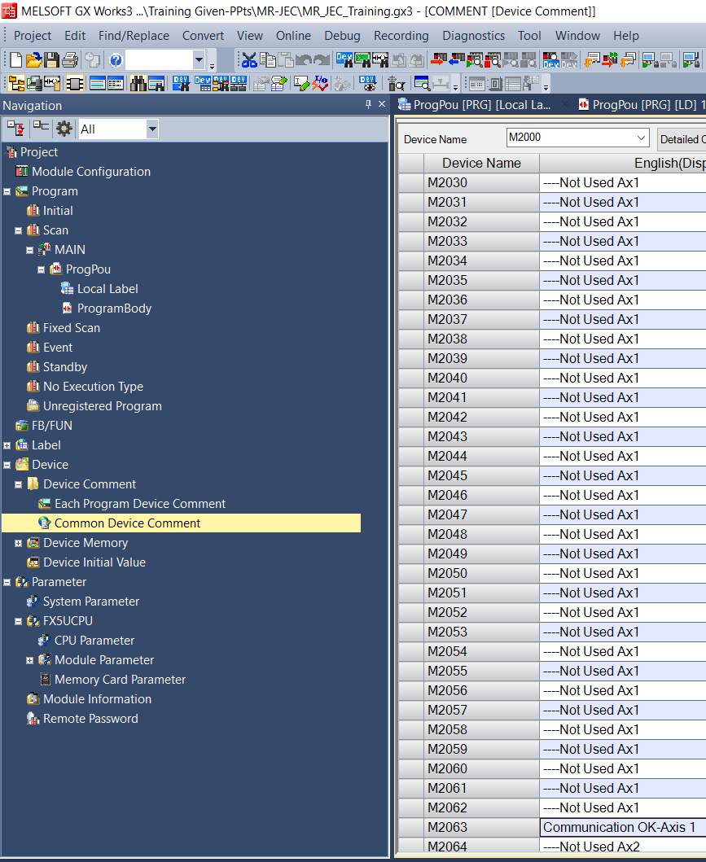
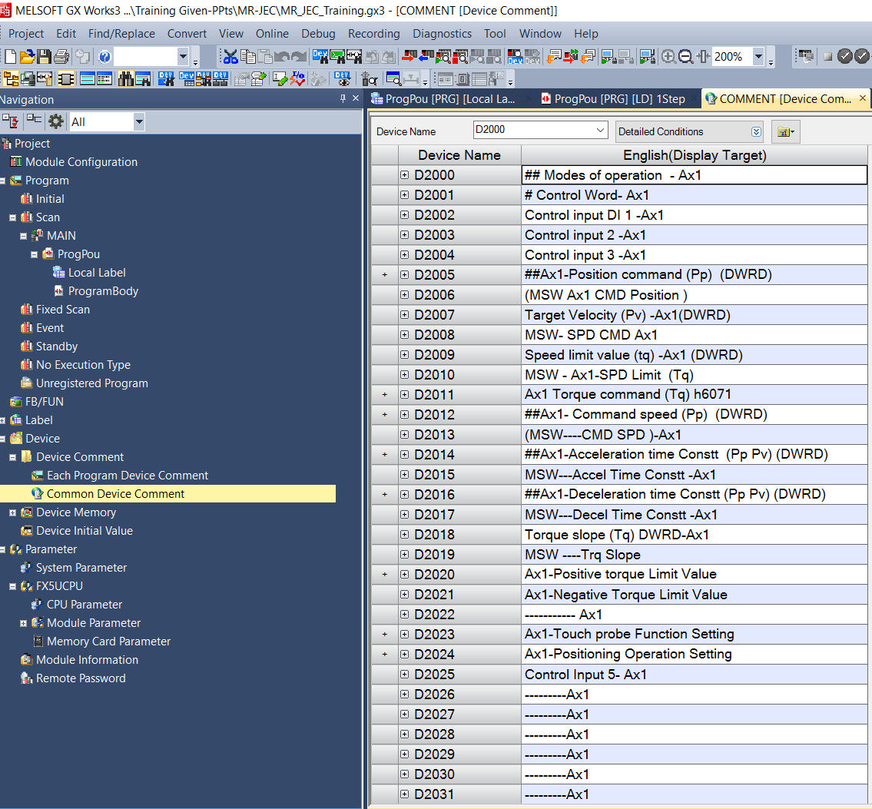
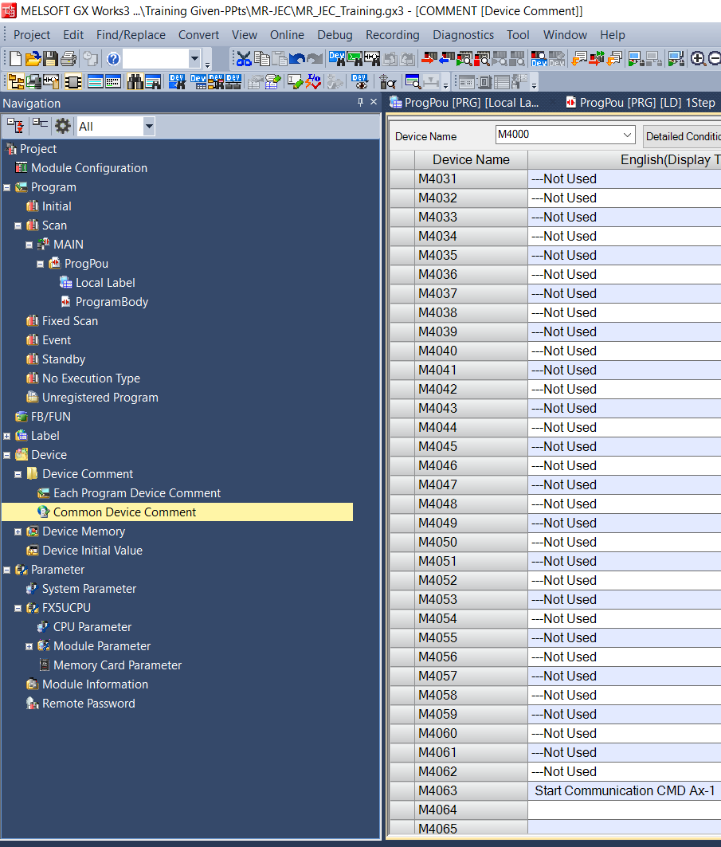
Adding Device Assembly Comment
->Add Device Comment in GX Works3 as per manual
Write Assembly
(Word)
Read Assembly
(Word)
Write Assembly
(Bits)
Read Assembly
(Bits)

Slide 39
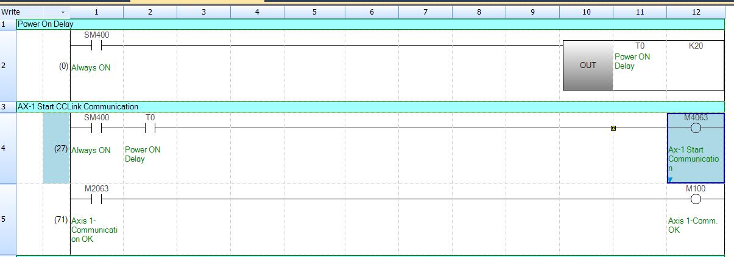
Creating Program
->Step1-Start Cyclic Communication

Slide 40
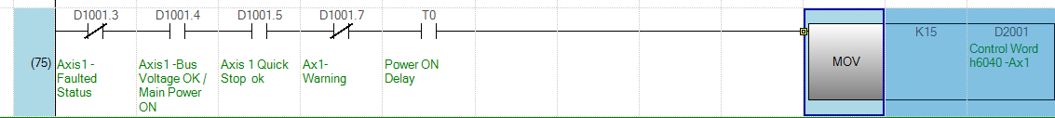
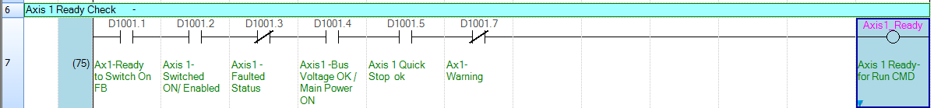
->Step2- Enabling the Servo (SON)
->Step3-Check for Axis Ready

Slide 41
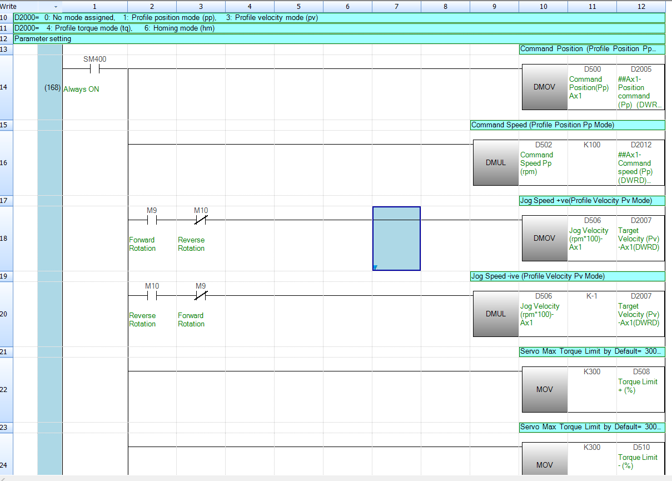
Write Basic Parameters Values-Page1
->Step4 – Set & Monitor the Parameters

Slide 42
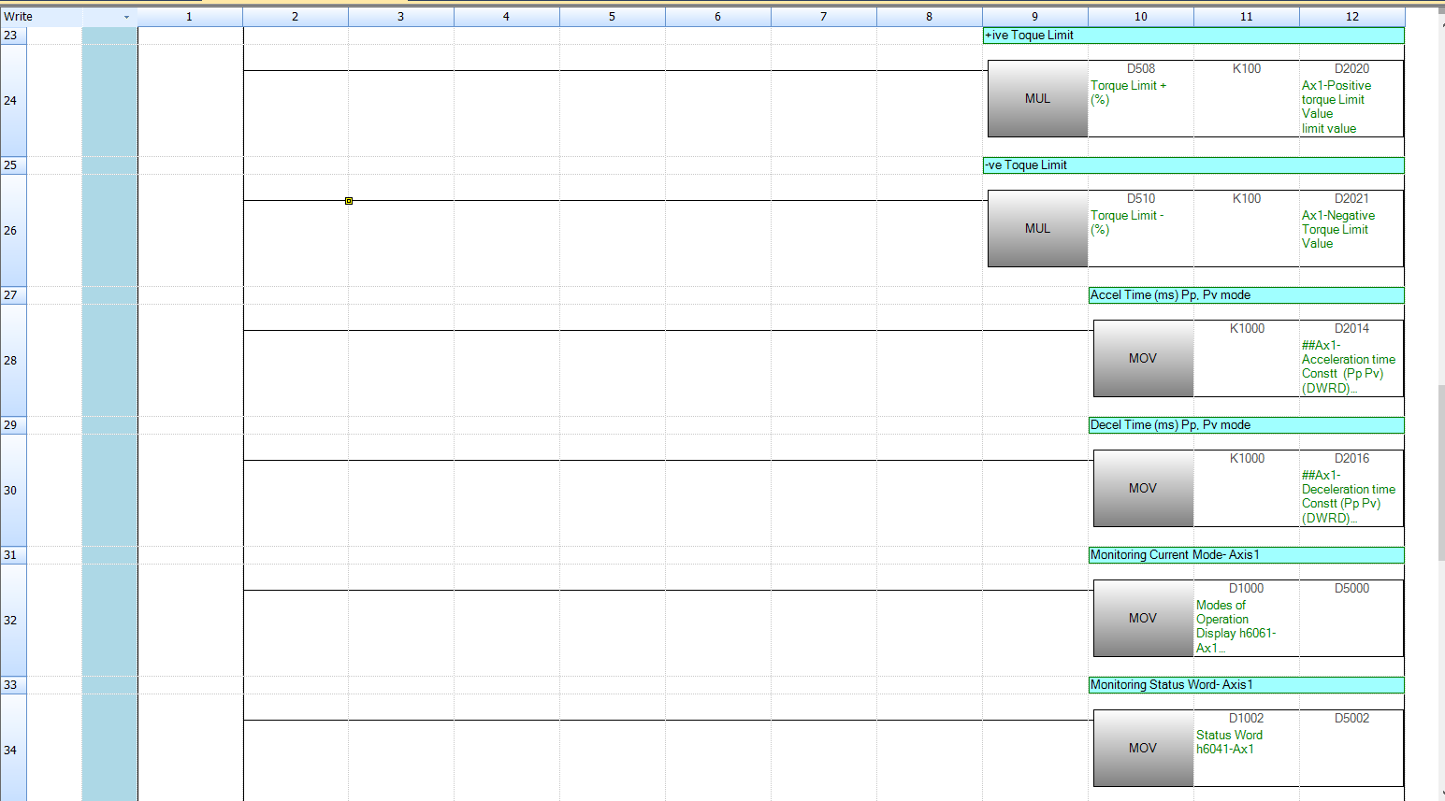
Write Basic Parameters Values-Page2

Slide 43
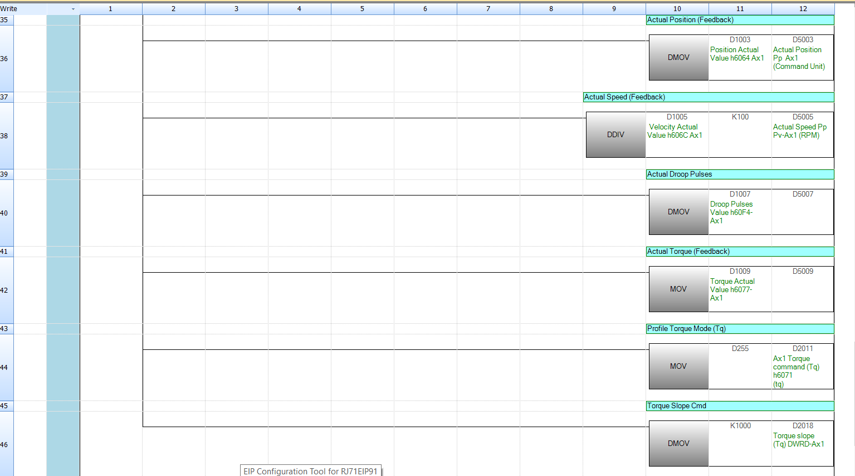
Write Basic Parameters Values-Page3

Slide 44
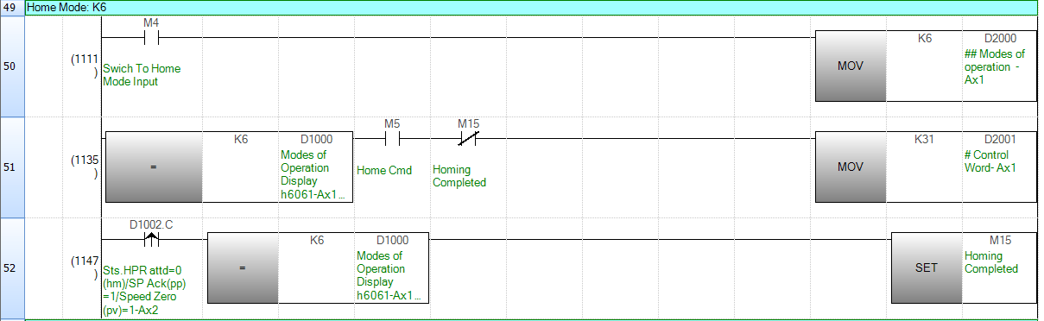
Homing Mode
->Step5 – Make the Servo Home

Slide 45
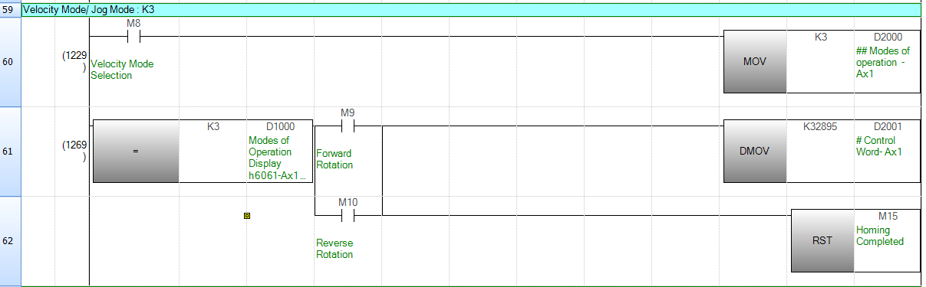
Jog Mode
->Step6 – Jog Mode

Slide 46
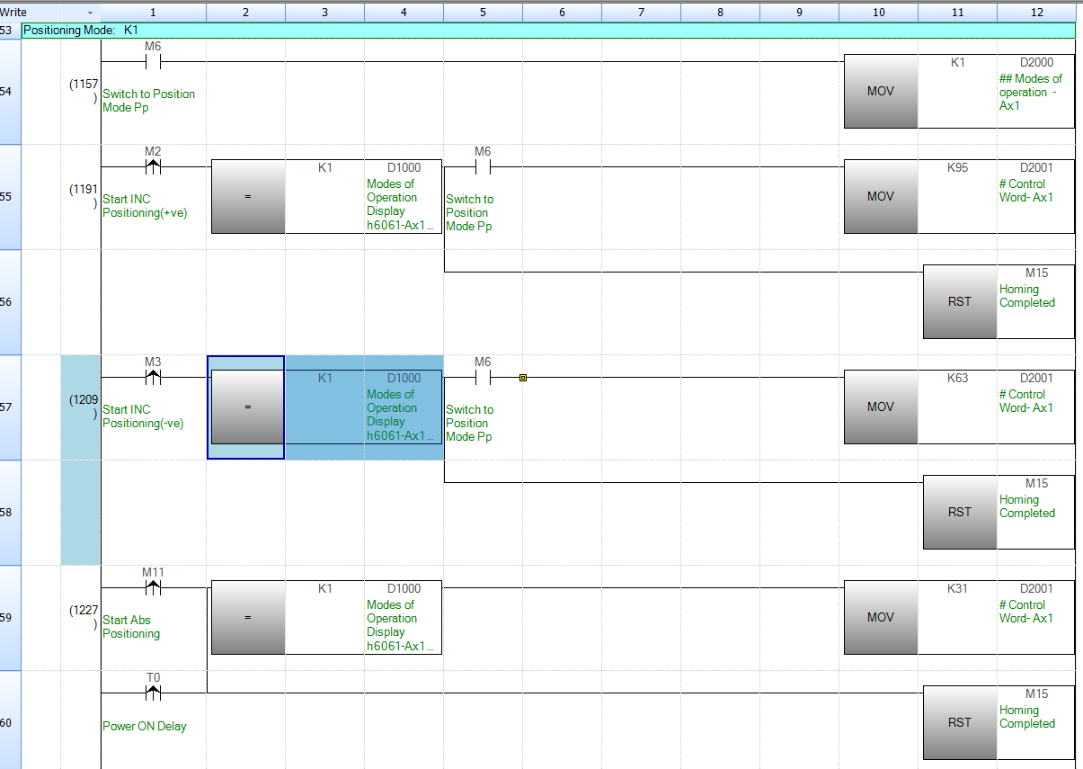
Profile Position Mode Pp
->Step6 – Servo Absolute and Incremental Positioning

Slide 47
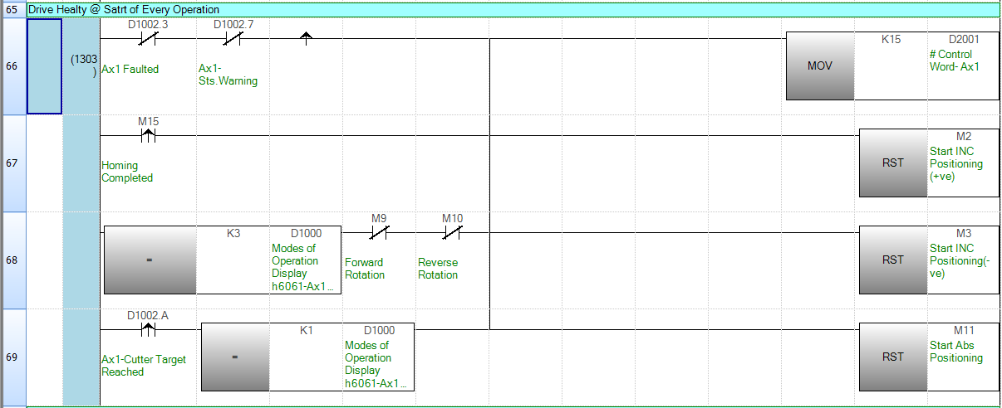
->Step7 – Action at the End of Every Operation before Next Start Trigger

Slide 48
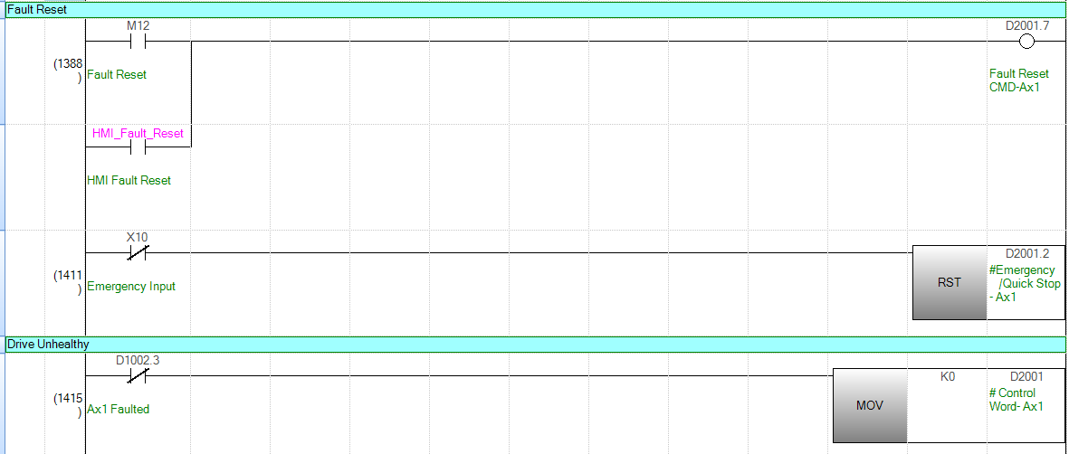
Servo Alarm Reset
->Step7 – Resetting the Servo Fault

Slide 49
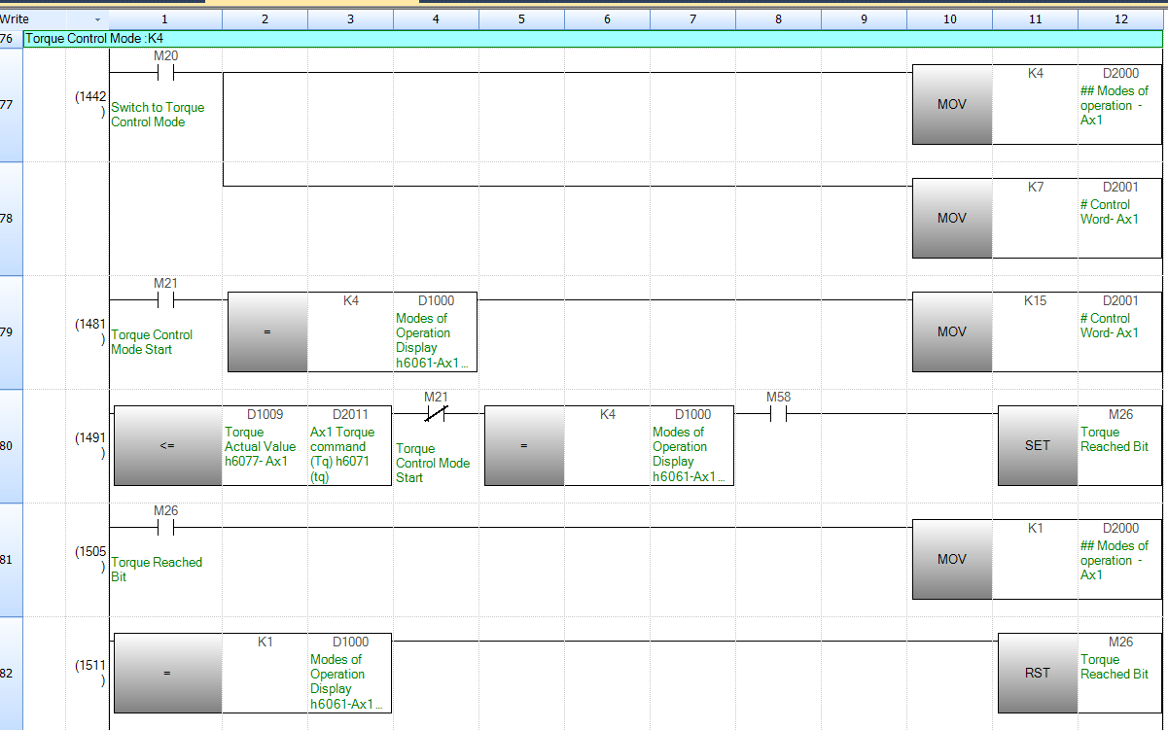
Torque Control Mode
->Step7 – Torque Control Mode

Slide 50
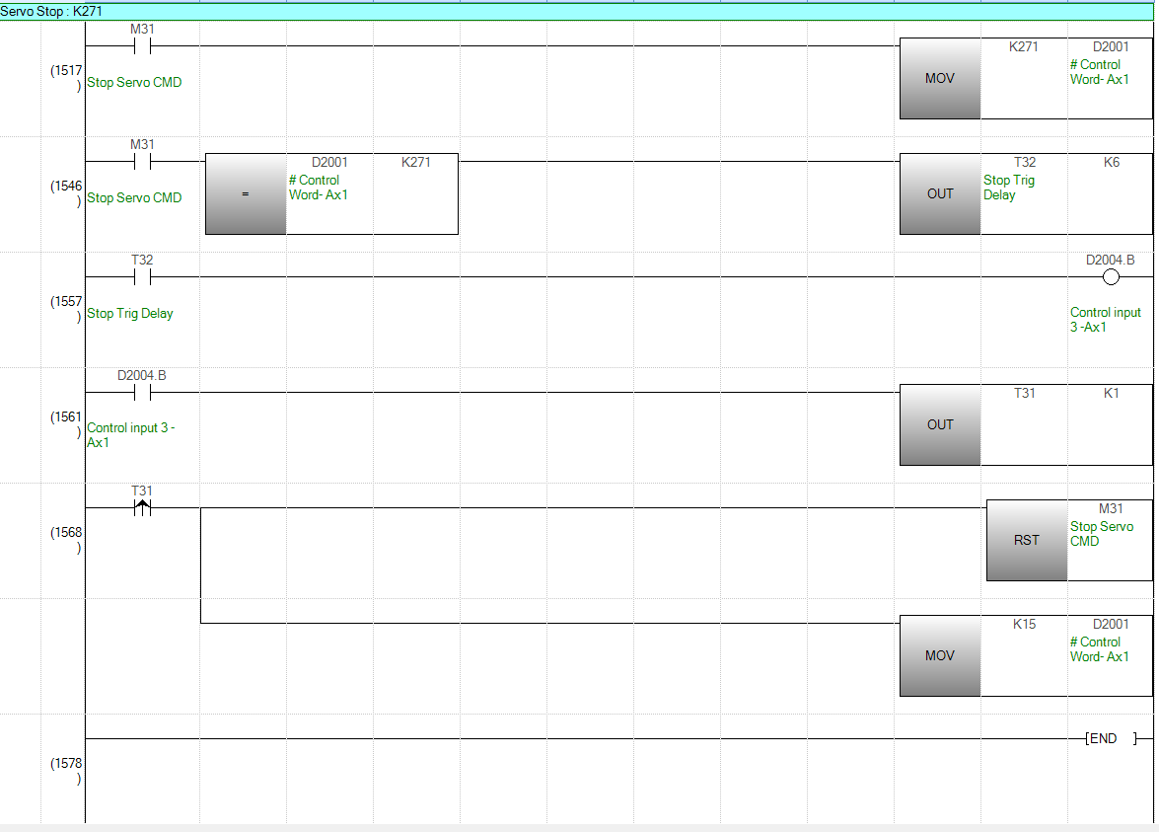
Stopping the Servo while movement
->Step7 – Stopping the Servo While Movement /Interrupting Servo Movement

Slide 51
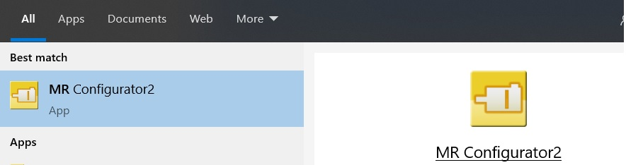
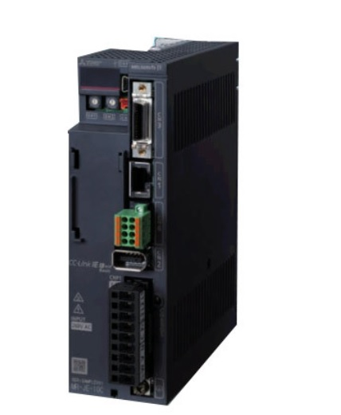
Creating MR-JEC Servo Program
MR-JEC

Slide 52

Open MR-Configurator2 and Add MR-JEC

Slide 53

Assign IP Address to MR-JEC

Slide 54

Select Control Mode
-> Select Control Mode to Profile Mode
-> Rotation direction can be selected from Rotation Direction Selection Tab

Slide 55

Select Position Detection Method
-> Select Position detection method selection – Absolute or Incremental

Slide 56

Set Electronic Gear
-> Set Electronic Gear and In Position Range in Position Control Tab

Slide 57

Setting Electronic Gear

Slide 58

Select Homing Method
-> Select Home Position Return Method
-> For Dog Based Homing and Limit Sensors , We also need MR-ECN1 /
MR-J2CMP2 CN1 Connector in MR-JEC

Slide 59

Make Auto ON assignments
-> If Not Using IO Connector , Make Auto On Assignment Under the Digital IO Tab for LSP,LSN & EM2/EM1

Slide 60

Tuning Mode Selection
-> Keep Gain Adjustment mode/Tuning Mode on Default Setting(Auto Tuning Mode1) at Startup and Later as per the application requirement
Download the Servo Program using Mini USB Cable

